Slide 1



















作业
Convert RE 0(0+1)*10* to $ε$-NFA, and convert this $ε$-NFA to a DFA
$$ε$$
4
$$0$$
5
$$ε$$
$$ε$$
$$ε$$
$$0$$
$$ε$$
$$ε$$
$$1$$
$$ε$$
$$ε$$
$$0$$
$$ε$$
1
2
3
8
9
10
11
12
13
14
$$ε$$
$$1$$
$$ε$$
$$ε$$
6
7
$$ε$$

Slide 2



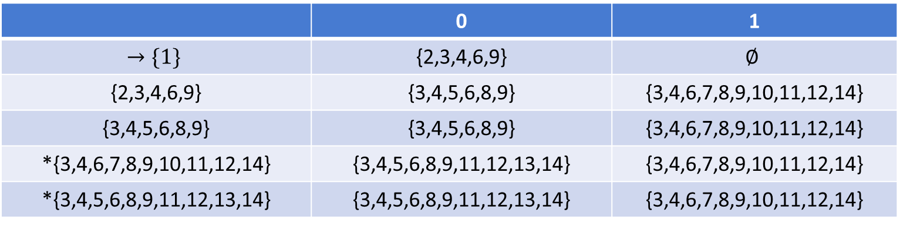


















convert $ε$-NFA to DFA
 | 0 | 1
$$→\{1\}$$ | {2,3,4,6,9} | $$∅$$
{2,3,4,6,9} | {3,4,5,6,8,9} | {3,4,6,7,8,9,10,11,12,14}
{3,4,5,6,8,9} | {3,4,5,6,8,9} | {3,4,6,7,8,9,10,11,12,14}
*{3,4,6,7,8,9,10,11,12,14} | {3,4,5,6,8,9,11,12,13,14} | {3,4,6,7,8,9,10,11,12,14}
*{3,4,5,6,8,9,11,12,13,14} | {3,4,5,6,8,9,11,12,13,14} | {3,4,6,7,8,9,10,11,12,14}
$$0$$
$$q_{1}$$
$$0$$
$$q_{2}$$
$$0$$
$$q_{3}$$
$$0$$
$$1$$
$$0$$
$$1$$
$0$,1
$$1$$
$$p_{1}$$
$$p_{2}$$
$$p_{3}$$
$$0$$
$$q_{4}$$
$$0$$
$$q_{5}$$
$$1$$
$$1$$

Slide 3












作业
Convert the following DFA to RE using state elimination technique
$$1$$
$$0$$
Start
$$0$$
$$1$$
$$p$$
$$q$$
$$r$$
$$1$$
$$0$$
$$0$$
$$1$$
$$s$$

Slide 4

















































Convert DFA to RE
Add new start state X and final state Y
Eliminate r
Eliminate q
Eliminate s
Eliminate p
Result:
  ${\left(1+0{\left(\left(0+{10}^{∗}1\right)1\right)}^{∗}\left(0+{10}^{∗}1\right)0\right)}^{∗}$
$$1$$
$$0$$
$$1$$
$$1$$
$$1$$
$${\left(1+0{\left(\left(0+{10}^{∗}1\right)1\right)}^{∗}\left(0+{10}^{∗}1\right)0\right)}^{∗}$$
$$\left(0+{10}^{∗}1\right)0$$
Start
Start
Start
Start
Start
$$0$$
$$ε$$
$$0$$
$$1$$
$$ε$$
$$ε$$
$$ε$$
$$q$$
$$Y$$
$$X$$
$$q$$
$$r$$
$$X$$
$$X$$
$$X$$
$$p$$
$$p$$
$$X$$
$$p$$
$$s$$
$$p$$
$$0{\left(\left(0+{10}^{∗}1\right)1\right)}^{∗}\left(0+{10}^{∗}1\right)0$$
$$0$$
$$1$$
$$1$$
$$0$$
$$0+{10}^{∗}1$$
$$\left(0+{10}^{∗}1\right)1$$
$$ε$$
$$1$$
$$ε$$
$$ε$$
$$ε$$
$$0$$
$$0$$
$$s$$
$$s$$
$$Y$$
$$Y$$
$$Y$$
$$Y$$

