Slide 1
形式语言与自动机理论
课程介绍
李钦 副教授
华东师范大学
软件工程学院

Slide 2
课程简介
课程内容
课程对象
课程安排和考核方式

Slide 3
what
Introduction to Automata Theory
  Finite state automata
  Pushdown automata
  Turing Machine
Introduction to Formal Language
  Regular language
  Context-free language
  Recursively enumerable language
Properties about them

Slide 4
why
Familiar with these concepts will make you a better computer scientist
It allow us to use mathematics to solve problems arising from computers
It is required if you are interested in a research career in Computer Science
It distinguishes you from someone who has picked up programming at a technique school
It gives exposure to some of the absolute highpoints of human thought
It gives a nice setting for improving your problem solving skills

Slide 5
Who
Research
  Theory of Software Engineering
  Computation Algorithms
Engineering
  Programming language Selection
  Model Driven Development
Preliminary: Discrete mathematics
  Set theory
  Predicate logics
  Programming experience

Slide 6
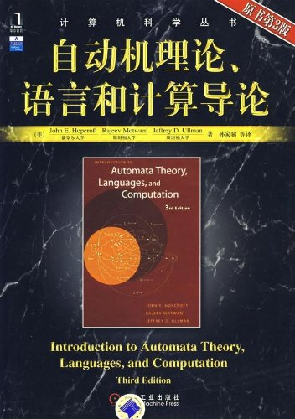
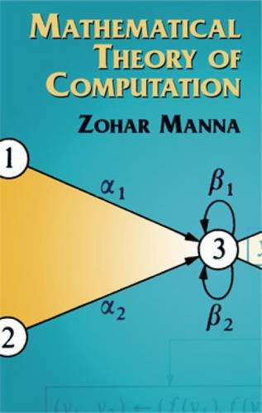
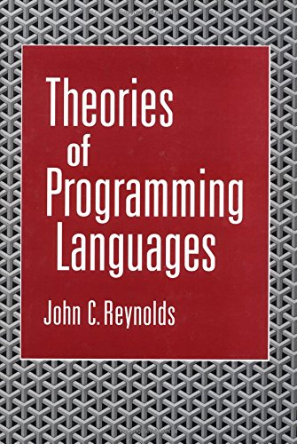
参考书目
John E. Hopcroft, Rajeev Motwani, Jeffrey D. Ullman. Introduction to Automata Theory, Languages, and Computation.
Zohar Manna. Mathematical Theory of Computation.
John C. Reynolds. Theories of Programming Languages.

Slide 7
课程安排
Preliminary 1 sessions
(Set theory, Predicate logic)
Automata Theories 6 sessions
(Finite Automata, Pushdown Automata, Turing machines)
Formal Languages 6 sessions
(RL, CFL, REL)
Properties and Proofs 4 sessions

Slide 8
考核方式
期末考查 60%
平时成绩 40%
  考勤 20%
  作业 20%

Slide 9
联系方式
李钦
理科楼B1001
Tel: 62233019
Email: qli@sei.ecnu.edu.cn

