Slide 1
形式语言与自动机理论
S2-3 正则语言
李钦 副教授
华东师范大学
软件工程学院

Slide 2

正则语言
正则表达式（Regular Expression）
  Basis: $ε, ∅$ and $a∈Σ$ are RE
  Inductive:
    if $r_{1},r_{2}$ are RE, then $r_{1}+r_{2}$, $r_{1}.r_{2}$ are RE
    If $r$ is RE, then $r^{∗}$ is RE
正则语言 $L(RE)$
  Basis: $L\left(ε\right)=\{ε\}$, $L\left(∅\right)=∅$, $L\left(a\right)=\{a\}$
  Inductive:
    $L\left(r_{1}+r_{2}\right)=L\left(r_{1}\right)∪L\left(r_{2}\right)$
    $L\left(r_{1}.r_{2}\right)=L\left(r_{1}\right)L\left(r_{2}\right)$
    $L\left(r^{∗}\right)=L{\left(r\right)}^{∗}$

Slide 3

Example
${\left(a+b\right)}^{∗}cd$ $L=\left\{wcd \right| w∈{\left\{a,b\right\}}^{∗}\}$
${\left(aa\right)}^{∗}{\left(bb\right)}^{∗}b$ $L=\left\{a^{2n}b^{2m+1}\right|n≥0,m≥0\}$
A RE that describe decimal numbers
  $\left(−+ε\right){\left(0..9\right)}^{∗}\left(.+ε\right)\left(0..9\right){\left(0..9\right)}^{∗}$
Strings with alternating 0 and 1
  $(ε+1){\left(01\right)}^{∗}(ε+0)$
Strings with no pair of consecutive 0
  ${\left(1+01\right)}^{∗}(0+ε)$

Slide 4
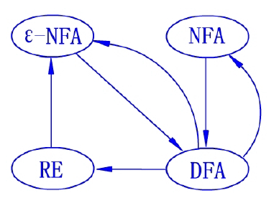

有限自动机和正则表达式等价
For every regular expression R there is a $ε$-NFA A such that L(A) = L(R).
For every DFA A we can find a regular expression R such that L(R) = L(A).

Slide 5
























From RE to $ε$-NFA
$$q_{0}$$
$$ε$$
$$q_{1}$$
Basis: Automata for $ε, ∅, a$
Inductive: Automata for $R+S, R.S,R^{∗}$
$$q_{0}$$
$$q_{1}$$
$$R$$
$$a$$
$$ε$$
$$ε$$
$$q_{0}$$
$$q_{1}$$
$$ε$$
$$ε$$
$$S$$
$$ε$$
$$ε$$
$$ε$$
$$ε$$
$$R$$
$$S$$
$$R$$
$$ε$$

Slide 6








































Example
Convert ${\left(0+1\right)}^{∗}1(0+1)$ to $ε$-NFA
$$ε$$
$$ε$$
$$ε$$
$$0$$
$$0$$
$$0$$
$$0$$
$$ε$$
$$ε$$
$$ε$$
$$ε$$
$$ε$$
$$ε$$
$$ε$$
$$ε$$
$$ε$$
$$ε$$
$$ε$$
$$ε$$
$$ε$$
$$ε$$
$$1$$
$$1$$
$$0$$
$$ε$$
$$ε$$
$$ε$$
$$ε$$
$$ε$$
$$ε$$
$$ε$$
$$ε$$
$$ε$$
$$ε$$
$$1$$
$$ε$$
$$1$$
$$1$$
$$1$$
$$ε$$
$$ε$$
$$ε$$
$$ε$$
$$ε$$
$$1$$
$$(0+1)$$
$${\left(0+1\right)}^{∗}1$$
$${\left(0+1\right)}^{∗}$$
$${\left(0+1\right)}^{∗}1(0+1)$$

Slide 7

From RE to DFA
RE
$ε$-NFA
NFA
DFA

Slide 8
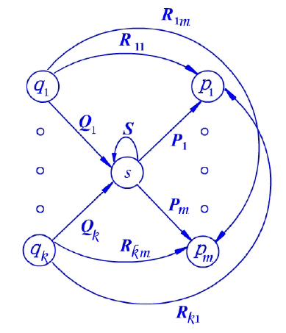
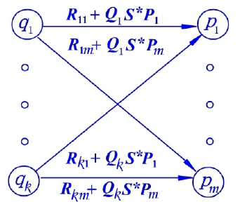
From FA to RE
State elimination technique
  Label the edges with regular expression instead symbols
  Eliminate state s

Slide 9

State elimination technique
Re-assign an initial state X and a final state Y to the Automata with $ε$-transition
Eliminate all states except X and Y following the above reduction rule
The regular expression is at the only edge left between X and Y

Slide 10
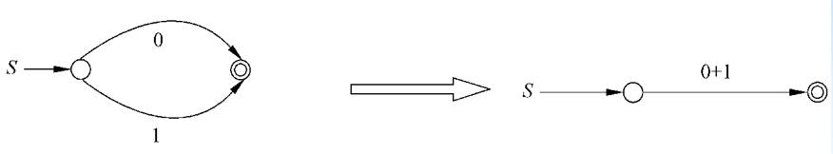
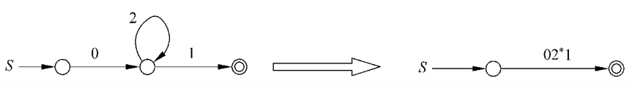
Elimination
Merge:
Eliminate sequential state:
Eliminate loop state:

Slide 11
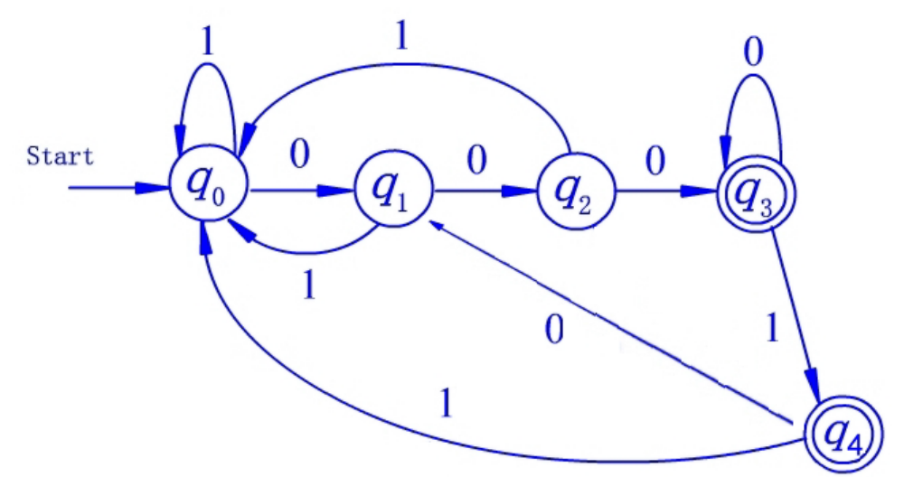
Example
Construct a RE from the following automata

Slide 12
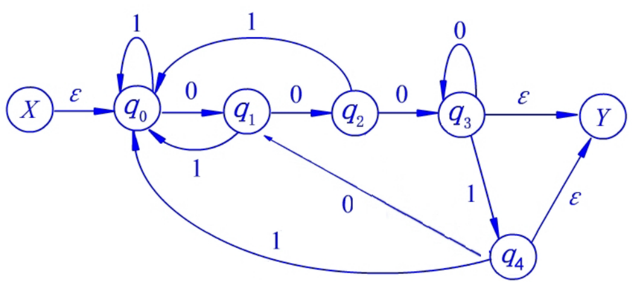
Example
Label X and Y states as start and final states

Slide 13
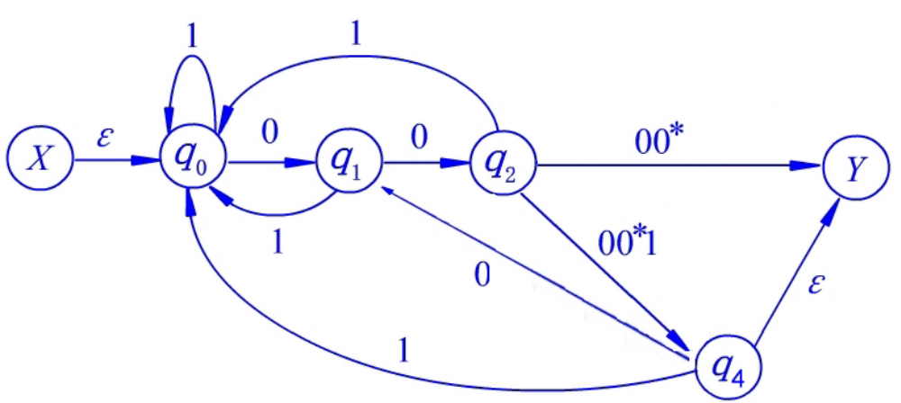
Example
Eliminate state q3

Slide 14
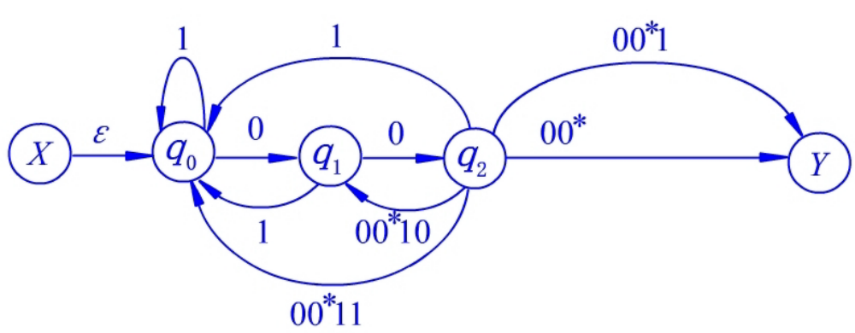
Example
Eliminate state q4

Slide 15
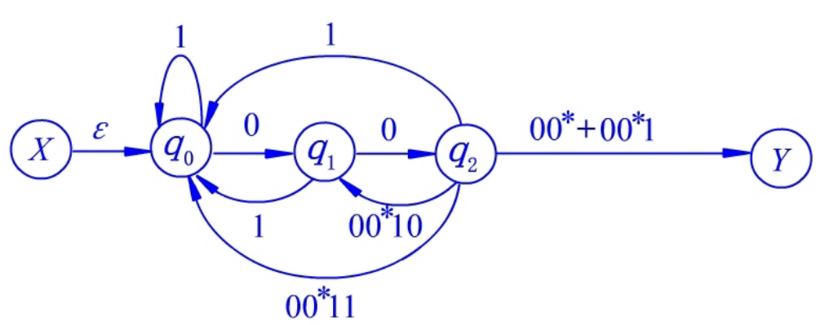
Example
Combine

Slide 16
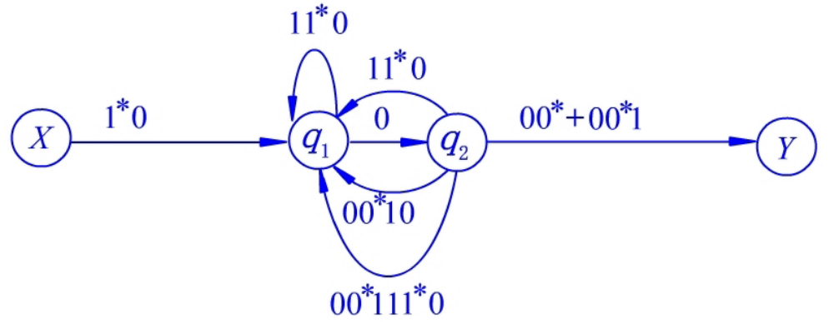
Example
Eliminate state q0

Slide 17
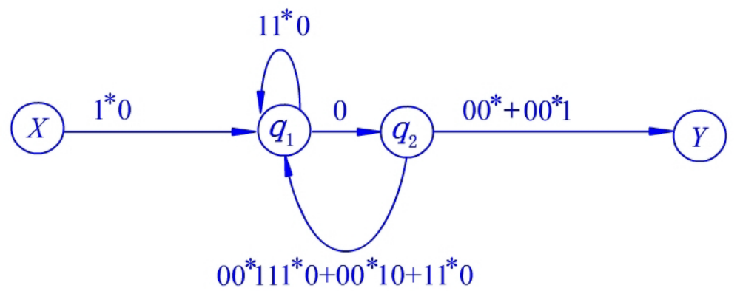
Example
Combine

Slide 18
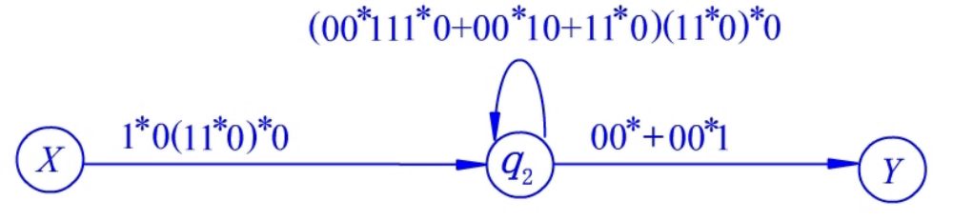
Example
Eliminate state q1

Slide 19
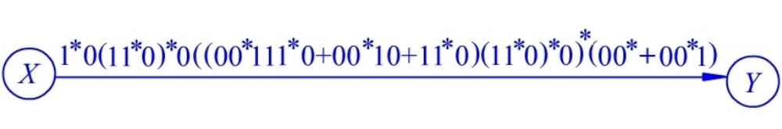
Example
Eliminate state q2

Slide 20













课后作业
Convert RE 0(0+1)*10* to $ε$-NFA, and convert this $ε$-NFA to a DFA
Convert the following DFA to RE using state elimination technique
$$1$$
$$0$$
Start
$$0$$
$$1$$
$$p$$
$$q$$
$$r$$
$$1$$
$$0$$
$$0$$
$$1$$
$$s$$

Slide 21

有限自动机与正则文法
正则文法：
  $G=(N,Σ,P,S)$
  Every production in P is of the form $A→σB$ or $A→σ$
  where $A,B∈N$ and $σ∈Σ^{∗}$

Slide 22

有限自动机与正则文法等价性
L can be accepted by a NFA, if and only if L has a regular grammar
Proof:
Construct an equivalent regular grammar from a NFA
  Let $M=(Q,Σ,δ,q_{0},F)$ with $Q=\{q_{0},…,q_{n}\}$
  Construct a grammar $G=(\left\{S_{0},…,S_{n}\right\},Σ,P,S_{0})$
    $S_{i}→aS_{j}$ if $q_{j}∈δ(q_{i},a)$ and $q_{j}∉F$
    $S_{i}→aS_{j} | a$ if $q_{j}∈δ(q_{i},a)$ and $q_{j}∈F$

Slide 23
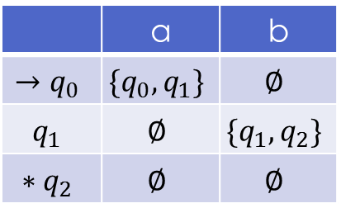

Example
$G=(\left\{S_{0},S_{1},S_{2}\right\},\left\{a,b\right\},P,S_{0})$
$S_{0}→aS_{0}| aS_{1}$
$S_{1}→bS_{1} \left| bS_{2} \right| b$
 | a | b
$$→q_{0}$$ | $$\{q_{0},q_{1}\}$$ | $$∅$$
$$q_{1}$$ | $$∅$$ | $$\{q_{1},q_{2}\}$$
$$∗q_{2}$$ | $$∅$$ | $$∅$$

Slide 24

有限自动机与正则文法等价性
2. Construct an equivalent $ε$-NFA from regular grammar
  Let $G=(N,Σ,P,S)$
  Construct $M=(Q,Σ,δ,\left[S\right],[ε])$
    $δ\left(\left[A\right],ε\right)=\left\{\left[α\right] \right| A→α∈P\}$
    $δ\left(\left[aα\right],a\right)=\{\left[α\right]\}$ if $a∈Σ$, $α∈Σ^{∗}N$

Slide 25
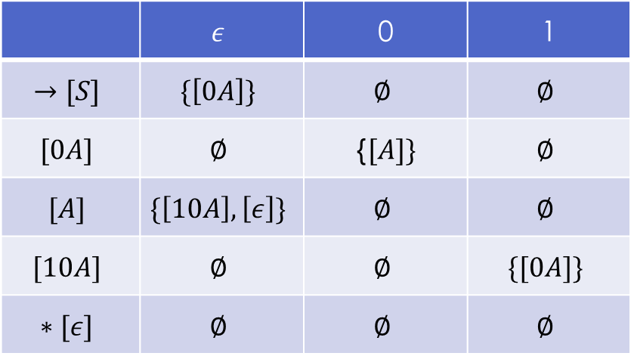

Example
$G=(\left\{S,A\right\},\left\{0,1\right\},P,S)$
$S→0A$
$A→10A | ε$
 | $$ε$$ | 0 | 1
$$→[S]$$ | $$\{\left[0A\right]\}$$ | $$∅$$ | $$∅$$
$$[0A]$$ | $$∅$$ | {$[A]\}$ | $$∅$$
$$[A]$$ | $$\{\left[10A\right],\left[ε\right]\}$$ | $$∅$$ | $$∅$$
$$[10A]$$ | $$∅$$ | $$∅$$ | $$\{[0A]\}$$
$$∗[ε]$$ | $$∅$$ | $$∅$$ | $$∅$$

Slide 26
如何判定一个语言是正则语言
给定一个语言L，如何判定其是不是正则语言
  如果能够构造出一个接受该语言的有限状态自动机，则L是正则语言
  如果L能够被正则表达式表示，则L是正则语言
  如果L能够由正则语言通过封闭运算得到，则L是正则语言
  如果L不满足泵引理，则L不是正则语言

Slide 27

正则表达式性质
Let R and S be RE with the same alphabet $Σ$,
R=S iff $L\left(R\right)=L(S)$
Commutativity & Associativity
  $R+S=S+R$
  $\left(RS\right)T=R(ST)$
  $\left(R+S\right)+T=R+(S+T)$
Identity & Annihilator
  $∅+R=R+∅=R$
  $εR=Rε=R$
  $∅R=R∅=R$

Slide 28

正则表达式性质
Distributive
  $R\left(S+T\right)=RS+RT$
  $\left(R+S\right)T=RT+ST$
Idempotent
  $R+R=R$
  ${(R^{∗})}^{∗}=R^{∗}$
Closure
  $∅^{∗}=ϵ$ $ε^{∗}=ε$
  $R^{+}=RR^{∗}=R^{∗}R$
  $R?=ε+R$

Slide 29

正则语言的封闭性
正则语言对以下运算是封闭的
  Union $L∪M$
  Intersection $L∩M$
  Complement $\overline{L}=Σ^{∗}−L$
  Difference $L−M$
  Reversal $L^{R}=\left\{a_{n}a_{n−1}…a_{1} \right| a_{1}a_{2}…a_{n}∈L\}$
  Concatenation $LM$
  Star closure $L^{∗}$
  Homomorphism $h(L)$ $h:Σ_{L}→Σ_{M}^{∗}$
  Inverse homomorphism $h^{−1}(L)$ $h:Σ_{M}^{∗}→Σ_{L}^{∗}$

Slide 30


封闭性证明 $L_{1}∪L_{2}$
Let $L_{1}, L_{2}$ be regular languages. $L_{1}=L\left(G_{1}\right)$, $L_{2}=L\left(G_{2}\right)$
$G_{1}=\left(N_{1},Σ_{1},P_{1},S_{1}\right)$, $G_{2}=\left(N_{2},Σ_{2},P_{2},S_{2}\right)$
Construct grammar G
  $G=(N_{1}∪N_{2}∪\left\{S\right\}, Σ_{1}∪Σ_{2},P_{1}∪P_{2}∪\left\{S→S_{1}, S→S_{2}\right\},S)$
$L\left(G\right)=L\left(G_{1}\right)∪L\left(G_{2}\right)$
  Any string $w$ that can be derived with $G_{1}$ or $G_{2}$ can be derived with $G$ by first apply $S→S_{1}|S_{2}$

Slide 31


封闭性证明 $L_{1}∩L_{2}$
Let $L_{1}, L_{2}$ be regular languages. $L_{1}=L\left(M_{1}\right)$, $L_{2}=L\left(M_{2}\right)$
$M_{1}=\left(Q_{1},Σ,δ_{1},q_{1},F_{1}\right), M_{2}=\left(Q_{2},Σ,δ_{2},q_{2},F_{2}\right)$
Construct FA $M=(Q,Σ,δ,q,F)$
  $Q=Q_{1}×Q_{2}$, $F=F_{1}×F_{2}$
  $q=(q_{1},q_{2})$
  $δ\left(\left(p_{1},p_{2}\right),a\right)=(δ\left(p_{1},a\right),δ\left(p_{2},a\right))$
$L\left(M\right)=L\left(M_{1}\right)∩L(M_{2})$
  Any input string $w$, $M$ process a symbol as both $M_{1}, M_{2}$ process it.
  $M$ accepts $w$ when both $M_{1},M_{2}$ accept it.

Slide 32
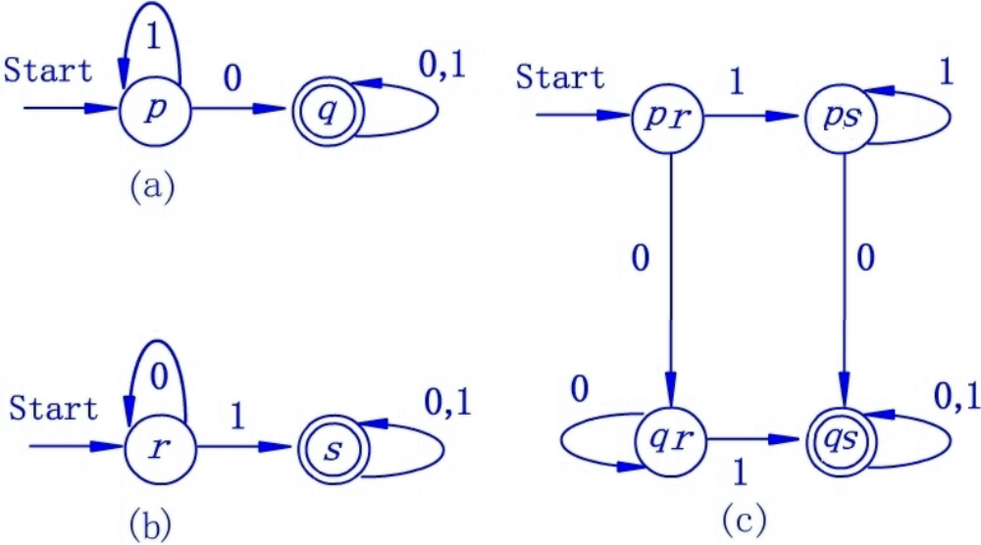

Example
$c=a×b$

Slide 33


封闭性证明 $\overline{L}$, $L−M$
Let $L$ be regular language. $L=L(M)$
$M=(Q,Σ,δ,q,F)$
Construct $M^{′}=(Q,Σ,δ,q,Q−F)$
$L\left(M^{′}\right)=Σ^{∗}−L\left(M\right)=\overline{L}$
Let $L,M$ be regular languages.
$L−M=L∩\overline{M}$

Slide 34


封闭性证明 $L^{R}$
Let $L$ be regular language. $L=L(M)$
$M=(Q,Σ,δ,q,F)$ be a $ε$-NFA
Construct $M^{′}=(Q′,Σ,δ^{′},q^{′},F^{′})$
  $Q^{′}=Q∪\{f\}$
  $q^{′}=f$ $F^{′}=\{q\}$
  for every $\left(s,a,t\right)∈δ$, $\left(t,a,s\right)∈δ′$
  for every $p∈F$, $δ^{′}\left(f,ε\right)=\left\{p \right| p∈F\}$
$L\left(M^{′}\right)=L^{R}$
  for any $w∈L(M)$, $w^{R}∈L(M^{′})$

Slide 35


封闭性证明 $L_{1}L_{2}$
Let $L_{1}, L_{2}$ be regular languages. $L_{1}=L\left(G_{1}\right)$, $L_{2}=L\left(G_{2}\right)$
$G_{1}=\left(N_{1},Σ_{1},P_{1},S_{1}\right)$, $G_{2}=\left(N_{2},Σ_{2},P_{2},S_{2}\right)$
Construct $G=\left(N_{1}∪N_{2},Σ_{1}∪Σ_{2},P_{2}∪P,S_{1}\right)$
  $P=\left\{A→aB \right| A→aB∈P_{1}\}∪\{A→aS_{2} | A→a∈P_{1}\}$
$L\left(G\right)=\left\{w_{1}w_{2}\right| w_{1}∈L\left(G_{1}\right), w_{2}∈L(G_{2})\}$
  $S_{1}⇒_{G_{1}}^{∗}w_{1}$, $S_{2}⇒_{G_{2}}^{∗}w_{2}$
  $S_{1}⇒_{G}^{∗}w_{1}S_{2}⇒_{G}^{∗}w_{1}w_{2}$

Slide 36


封闭性证明 $L^{∗}$
Let $L$ be regular language. $L=L\left(G\right)$
$G=\left(N,Σ,P,S\right)$
Construct $G′=\left(N_{1}∪\left\{S_{0}\right\},Σ, P′,S_{0}\right)$
  $P^{′}=P∪\left\{S_{0}→ε \right| S\}∪\left\{A→aS \right| A→a∈P\}$
$L\left(G′\right)=\left\{ε\right\}∪\left\{w^{n}\right| w∈L\left(G\right), n≥1\}$
  $S⇒_{G}^{∗}w$
  $S_{0}⇒_{G′}ε$
  $S_{0}⇒_{G′}S⇒_{G′}^{∗}wS$

Slide 37


封闭性证明 $h(L)$
Let $L$ be regular language. $L=L(E)$ with $Σ_{1}$
Homomorphism $h:Σ_{1}^{∗}→Σ_{2}^{∗}$
  $h\left(w_{1}w_{2}\right)=h\left(w_{1}\right)h(w_{2})$
  $h\left(w_{1}+w_{2}\right)=h\left(w_{1}\right)+h\left(w_{2}\right)$
  $h\left(w^{∗}\right)=h{\left(w\right)}^{∗}$
$h\left(L\right)=\left\{h\left(w\right) \right| w∈L\}$
Example:
  $h:{\left\{0,1\right\}}^{∗}→{\left\{a,b\right\}}^{∗}$
  $h\left(0\right)=ab$, $h\left(1\right)=ε$
  $h\left(L\left({10}^{∗}1\right)\right)=L({\left(ab\right)}^{∗})$

Slide 38

封闭性证明 $h(L)$
$L\left(h\left(E\right)\right)=h\left(L\left(E\right)\right)$
  basis:
  $L\left(h\left(E\right)\right)=h\left(L\left(E\right)\right)$ holds for $E=ε, ∅$
  if $E=a$, $L\left(h\left(E\right)\right)=L\left(h\left(a\right)\right)=\left\{h\left(a\right)\right\}=h(\{a\})$
  inductive:
  if $E=F+G$, $h\left(L\left(E\right)\right)=h\left(L\left(F+G\right)\right)=h\left(L\left(F\right)∪L\left(G\right)\right)$
  $=h\left(L\left(F\right)\right)∪h\left(L\left(G\right)\right)=L\left(h\left(F\right)\right)∪L\left(h\left(G\right)\right)=L\left(h\left(F\right)+h\left(G\right)\right)$
  $=L\left(h\left(F+G\right)\right)=L\left(h\left(E\right)\right)$
  the proof is similar for $E=FG$ and $E=F^{∗}$

Slide 39


封闭性证明 $h^{−1}(L)$
Let $L$ be regular language. $L=L(E)$ with $Σ_{1}$
Homomorphism $h:Σ_{2}^{∗}→Σ_{1}^{∗}$
$h^{−1}\left(L\right)=\left\{w \right| w∈Σ_{2}^{∗}, h\left(w\right)∈L\}$
Example:
  $h:{\left\{a,b\right\}}^{∗}→{\left\{0,1\right\}}^{∗}$
  $h\left(a\right)=01, h\left(b\right)=10$
  $h^{−1}(L{(\left(1+00\right)}^{∗}))=L((b{a)}^{∗})$

Slide 40

封闭性证明 $h^{−1}(L)$
Let $L = L(M)$ for DFA $M=(Q,Σ_{1},δ_{1},q,F)$.
Construct a DFA for $h^{−1}\left(L\right)$ from $A$ and $h$
$M^{′}=(Q,Σ_{2},δ_{2},q,F)$
  $δ_{2}\left(p,a\right)={\hat{δ}}_{1}(p,h(a))$
$h(L\left(M^{′}\right))=L(M)$
  for any string $w∈L(M^{′})$, $h\left(w\right)∈L(M)$
  $L\left(M^{′}\right)=h^{−1}\left(L\left(M\right)\right)$

Slide 41
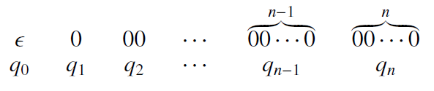

使用泵引理证明一个语言不是正则语言
正则语言都满足泵引理
如果不满足泵引理，则不是正则语言
Example: $L=\{0^{n}1^{n}|n≥1\}$ is not a RL
反证法：
  Suppose L is RL, then there is a DFA with n state accepts it
  Let the DFA read $0^{n}$, it will travel the states $q_{0},…,q_{n}$
  Since DFA only has n states, there must be at least one state $q_{i}=q_{j}$ between $q_{0}$ and $q_{n}$. Denote it as $q$.
  Consider $\hat{δ}\left(q,1^{i}\right)$
    if $\hat{δ}\left(q,1^{i}\right)∈F$, then DFA will accept string $0^{j}1^{i}$, Contradiction
    if $\hat{δ}\left(q,1^{i}\right)∉F$, then DFA will reject string $0^{i}1^{i}$, Contradiction

Slide 42

Pumping lemma（泵引理）
Let L be a regular language. Then there exists a constant n such that for every string $w∈L$with $\left|w\right|≥n$, we can break w into three substrings
$w=xyz$ such that
  $y≠ε$
  $\left|xy\right|≤n$
  For all $k≥0$, $xy^{k}z∈L$

Slide 43
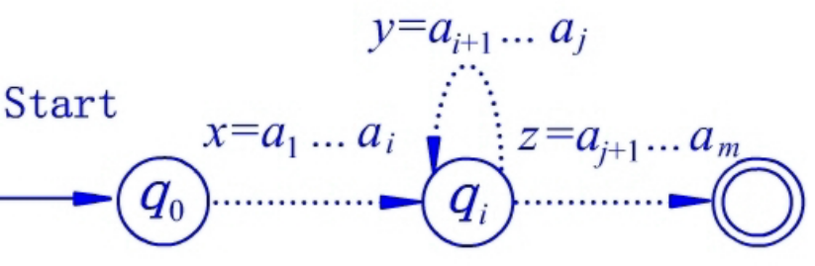

泵引理的证明
L is recognized by some DFA A with n states.
Let $w=a_{1}a_{2}…a_{m}∈L, m>n$, and let $q_{k}=\hat{δ}\left(q_{0},a_{1}a_{2}…a_{k}\right), k=1,2,…,m$
By the pigeonhole principle, $∃i<j≤n∙q_{i}=q_{j}$
Break $w=xyz$ as follows
  $x=a_{1}…a_{i}$ $y=a_{i+1}…a_{j}$ $z=a_{j+1}…a_{m}$
  we can obtain that
    $y≠ε$ since $i<j$
    $\left|xy\right|≤n$ since $j≤n$
    for any $k≥0$, $xy^{k}z∈L$

Slide 44


Example
Let $L_{do}=\{ww|w∈{\left\{0,1\right\}}^{∗}\}$. Show L is not a RL.
Proof: Suppose L is regular
Let $w=0^{n}{10}^{n}1∈L_{do}$
By the pumping lemma, break $w=xyz$ with
$y≠ε$, $\left|xy\right|≤n$, $xy^{k}z∈L_{do}$
Check whether $xyyz∈L_{do}$
  $xyyz=0^{m}{10}^{n}1$ with $m>n$
  $xyyz∉L_{do}$ Contradiction

Slide 45

课后作业
证明$L=\left\{0^{n}1^{m}\right| n=2m\}$不是正则语言

Slide 46

Myhill–Nerode theorem
Provides a necessary and sufficient condition for a language to be regular
Distinguishing Extension:
  Given a language $L$ and two strings $x,y$
  String $z$ such that exactly one of $xz$ and $yz$ belongs to $L$
Myhill–Nerode Relation $R_{L}$
  $\left(x,y\right)∈R_{L}$ iff there is no distinguishing extension for $x,y$
  $R_{L}$ is an equivalence relation
  $R_{L}$ divides $Σ^{∗}$ into many equivalence classes

Slide 47

Myhill–Nerode theorem
Language $L$ is regular if and only if $R_{L}$ has a finite number of equivalence classes
The number of states in the smallest DFA recognizing $L$ is equal to the number of equivalence classes in $R_{L}$
There is a unique minimal DFA with minimum number of states recognizing $L$

Slide 48

Proof of Myhill–Nerode theorem
Sufficient Proof
Let $L$ be a regular language recognized by a DFA $A$ with $n$ states $q_{1}q_{2}…q_{n}$
$S_{i}⊆Σ^{∗}$ is the set of strings that given as input to $A$, end with state $q_{i}$
For every $x,y∈S_{i}$, $A$ reaches the same state with input $xz, yz$ for any string $z$, so we have $\left(x,y\right)∈R_{L}$
Therefore, $S_{i}$ is a subset of an equivalence class of $R_{L}$
There are at most $n$ equivalence classes of $R_{L}$

Slide 49

Proof of Myhill–Nerode theorem
Necessary Proof
$R_{L}$ has $n$ equivalence classes $S_{1}S_{2}…S_{n}$
Construct a DFA $A=(Q,Σ,δ,q,F)$
  $Q=\{q_{1},q_{2},…,q_{n}\}$ one state for each equivalence class
  Start state corresponds to the equivalence class of empty string $ε$
  For any string $x$ from an equivalence class $S_{i}$, $δ\left(q_{i},a\right)=q_{j}$ where the equivalence class corresponding to $q_{j}$ contains string $xa$
  $F$ contains the states that corresponds to the equivalence class containing a string in $L$
  Since any strings $x,y∈S_{i}$ do not have distinguishing extension, it implies that all strings in $L$ can be accepted by $A$

Slide 50
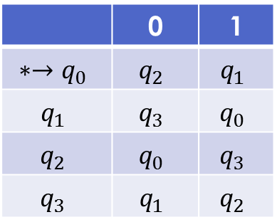

Example
Design a DFA to accept language
$L=\{ω|ω has even number of 0 and even number of 1\}$
States
  $q_{0}$: have seen even num of 0 and 1 both
  $q_{1}$: have seen even num of 0 and odd num of 1
  $q_{2}$: have seen odd num of 0 and even num of 1
  $q_{3}$: have seen odd num of 0 and 1 both
Transitions
 | 0 | 1
$$∗→q_{0}$$ | $$q_{2}$$ | $$q_{1}$$
$$q_{1}$$ | $$q_{3}$$ | $$q_{0}$$
$$q_{2}$$ | $$q_{0}$$ | $$q_{3}$$
$$q_{3}$$ | $$q_{1}$$ | $$q_{2}$$

Slide 51

有限自动机的最小化
Equivalent states: $p≡q$
  $A=\left(Q,Σ,δ,q_{0},F\right)$with $p,q∈Q$
  $∀w∈Σ^{∗}∙\hat{δ}\left(p,w\right)∈F⇔\hat{δ}\left(q,w\right)∈F$
Distinguishable states: $p≢q$
Minimize DFA
  find all equivalent states in a DFA
  replace them with one state

Slide 52

DFA最小化算法
Compute all distinguishable states in a given DFA
Table-Filling algorithm:
  Basic: if $p∈F$ and $q∉F$, then mark (p,q)
  Inductive: if there exists $a∈Σ$ such that $(δ\left(p,a\right),δ\left(q,a\right))$ is marked, then mark (p,q)
Merge all equivalent states

Slide 53
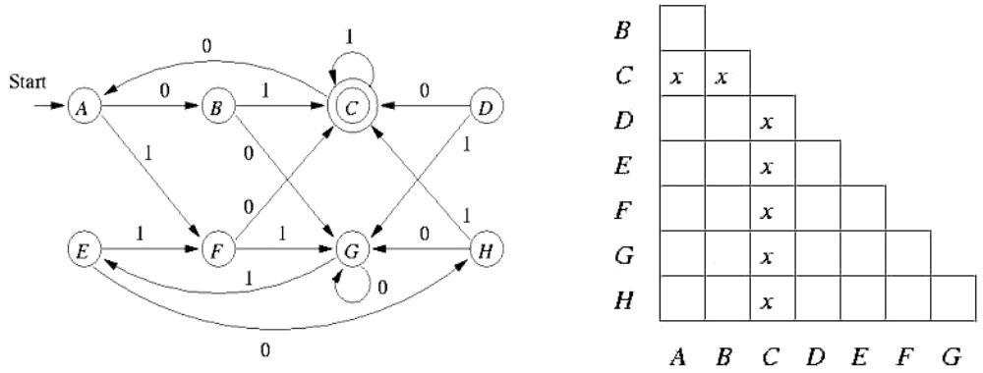
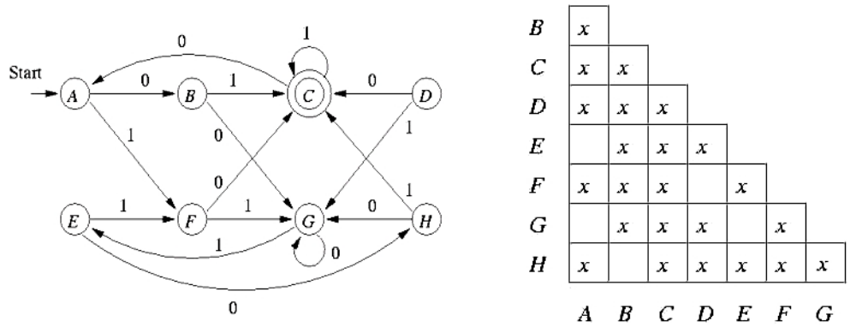


Example
Make a half table with states crossed
  for any $p∈F$ and $q∉F$, mark $(p,q)$
  for any unmarked $(p,q)$, if $∃a∈Σ$ such that $(δ\left(p,a\right),δ\left(q,a\right))$ is marked, then mark $(p,q)$

Slide 54















Example
Merge all equivalent states
$$1$$
$$0$$
$$1$$
Start
$$0$$
$$1$$
$$0$$
$$AE$$
$$BH$$
$$C$$
$$DF$$
$$0$$
$$1$$
$$1$$
$$G$$
$$0$$

Slide 55
判定性问题
decision problem:
  Given a language as a input
  determine a Boolean answer with a terminating algorithm
判定性问题的特点
  一般无法遍历集合中所有元素
  判定性问题的答案是yes or no
  可判定是指存在一个在有限时间内能终止的算法，对任意输入都可以得到一个确定的答案

Slide 56

正则语言中的判定性问题
Given a string $w$ and a regular language $L$, is $w∈L$?
Given a regular language $L$, is $L=∅$? $L=Σ^{∗}$? $L$ finite?
Given two regular languages $L_{1}$ and $L_{2}$,
is $L_{1}∩L_{2}=∅$? $L_{1}=L_{2}$?

Slide 57


$w∈L$？
If L is represented by a DFA, the algorithm is putting the string w as input and see if the DFA ends in a final state. The complexity is $O(n)$ for $\left|w\right|=n$
If L is represented by a NFA with s states, the algorithm considers all states the transition will reach for each input. It takes $O(ns^{2})$ for $\left|w\right|=n$
If L is represented by a $ε$-NFA with s states, the algorithm must compute $ε$-closure for every $ε$-transition. So it takes $O(ns^{3})$ for $\left|w\right|=n$

Slide 58

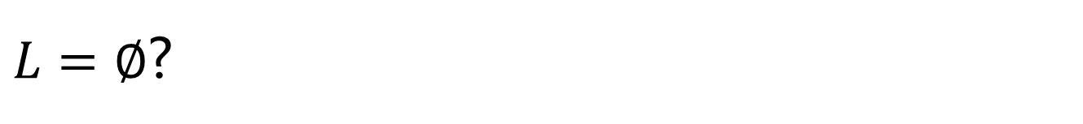
$L=∅$?
If L is represented as a FA, the question is whether there is a path from the initial state to some final states
The algorithm is a graph reachability algorithm which takes $O(n^{2})$ if FA has n states

Slide 59

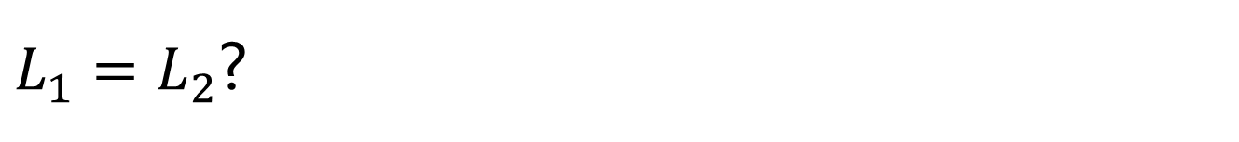
$L_{1}=L_{2}$?
Let $L_{1}$ and $L_{2}$ be regular languages
Convert them to DFAs
Simplify both DFAs
If the two DFAs are congruent, then $L_{1}=L_{2}$

Slide 60

$L_{1}=L_{2}$?
Let $L_{1}$ and $L_{2}$ be regular languages
Convert them to DFAs
Put the two DFAs together (has two start states)
Use TF-algorithm to determine if their start states are equivalent
If their start states are equivalent, then $L_{1}=L_{2}$

