Slide 1
形式语言与自动机理论
S3-1 下推自动机
李钦 副教授
华东师范大学
软件工程学院

Slide 2

上下文无关文法
A context-free grammar is a quadruple
$G = (V, T, P, S )$
  V is a finite set of variables.
  T is a finite set of terminals.
  P is a finite set of productions of the form $A→α$
  where $A∈V, α∈{\left(V∪T\right)}^{∗}$
  S is a designated variable called the start symbol

Slide 3

Example
Consider grammar $G_{pal}=(\left\{S\right\},\left\{0,1\right\},P,S)$
$P=\{S→ε, S→0, S→1, S→0S0, S→1S1\}$
Consider grammar $G=(\left\{E,I\right\},\left\{a,b,0,1,\left(,\right),+,×\right\},P,E)$
$E→I | E+E \left| E×E \right| (E)$
$I→a \left| b \right| Ia \left| Ib \right| I0 | I1$
Consider grammar $G_{if}=(\left\{S\right\},\left\{if,else\right\},P,S)$
$S→ε \left| SS \right| if S | if S else$

Slide 4

Derivation
Let $G = (V, T, P, S )$be a CFG, $A∈V$, $α,β∈{\left(V∪T\right)}^{∗}$, and $A→γ∈P$. Then we write
$αAβ⇒_{G}αγβ$
define $⇒^{∗}$ to be the reflexive and transitive closure of $⇒$
  basis: $α⇒^{∗}α$
  inductive: If $α⇒^{∗}β$, and $β⇒γ$, then $α⇒^{∗}γ$

Slide 5

Example
Derivation of $a×(a+b00)$ from $E$ in the production
  $E→I | E+E \left| E×E \right| (E)$
  $I→a \left| b \right| Ia \left| Ib \right| I0 | I1$
$E⇒E×E⇒I×E⇒a×E⇒a×\left(E\right)⇒a×\left(E+E\right)$
$⇒a×\left(I+E\right)⇒a×\left(a+E\right)⇒a×\left(a+I\right)$
$⇒a×\left(a+I0\right)⇒a×\left(a+I00\right)⇒a×(a+b00)$

Slide 6

leftmost & rightmost derivations
Leftmost derivation $⇒_{lm}$
  Always replace the leftmost variable by one of its rule-bodies.
Rightmost derivation $⇒_{rm}$
  Always replace the rightmost variable by one of its rule-bodies.

Slide 7
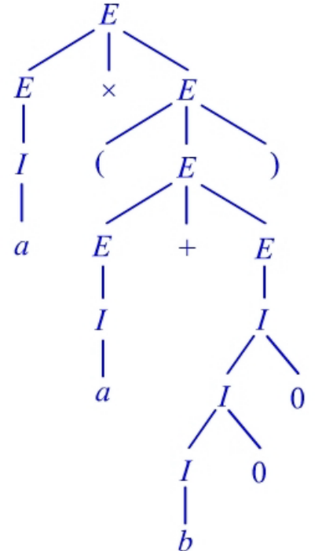

生成树 parse tree
A parse tree is an alternative representation to a derivation of a string $w∈L(G)$
Example: parse tree for a string $a×(a+b00)$

Slide 8

Ambiguous Grammar
There can be several different derivations for a string
There can be several parse trees for the same derivation of a string
There is only one parse tree for a derivation of string $w∈L(G)$ if $G$ is unambiguous

Slide 9
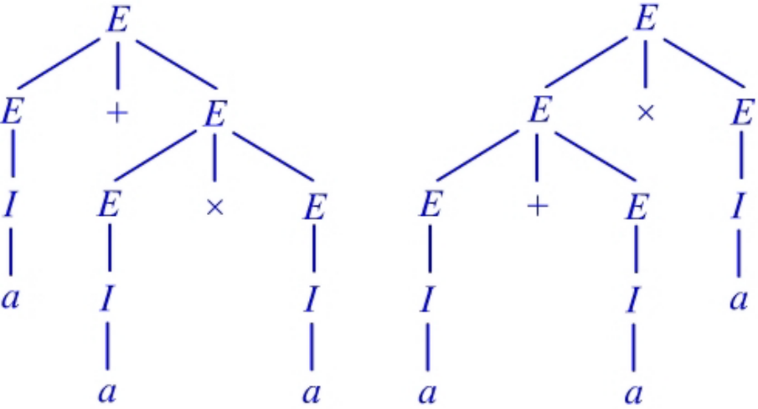

Example
$a+a×a$ has two derivations
  $E⇒E+E⇒E+E×E⇒I+I×I⇒a+a×a$
  $E⇒E×E⇒E+E×E⇒I+I×I⇒a+a×a$
It gives us two parse trees:
So this grammar is ambiguous

Slide 10

Ambiguous CFG
Let $G=(V,T,P,S)$ be a CFG. We say that G is ambiguous if there exists a string $w∈T^{∗}$ such that we can find two different parse trees yielding $w$
If every string in $L(G)$ has only one parse tree, then $G$ is unambiguous

Slide 11
Ambiguity
Good news: sometimes we can remove ambiguity from CFG
Bad news: there is no algorithm to do it
Bad news: There are CFLs that has only ambiguous grammars and it is impossible to remove the ambiguity
Good news: there are well-known techniques for eliminating ambiguity in common programming languages

Slide 12

Removing Ambiguity
Consider the grammar
$E→I \left| E+E \right| E×E | (E)$
$I→a \left| b \right| Ia \left| Ib \right| I0 | I1$
Causes of ambiguity:
  No precedence between $+$ and $×$
  No grouping of operator sequences $E+E+E$ should be $\left(E+E\right)+E$ or $E+(E+E)$
Solution:
  Enforce precedence by introducing more variables representing different binding strengths

Slide 13
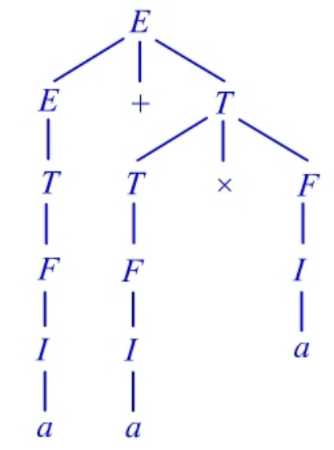

Removing Ambiguity
Convert the grammar as follows
$E→T | E+T$
$T→F | T×F$
$F→I | (E)$
$I→a \left| b \right| Ia \left| Ib \right| I0 | I1$
now $a+a×a$ has only one parse tree

Slide 14

Leftmost derivation and ambiguity
For any CFG $G$, a string w has two distinct parse trees iff w has two distinct leftmost derivation
Example:
  $E⇒_{lm}E+E⇒_{lm}I+E⇒_{lm}a+E⇒_{lm}a+E×E$
  $⇒_{lm}a+I×E⇒_{lm}a+a×E⇒_{lm}a+a×I⇒_{lm}a+a×a$
  $E⇒_{lm}E×E⇒_{lm}E+E×E⇒_{lm}I+E×E$
  $⇒_{lm}a+I×E⇒_{lm}a+a×E⇒_{lm}a+a×I⇒_{lm}a+a×a$

Slide 15

Inherent Ambiguity
A CFL $L$ is inherent ambiguous if all grammars for $L$ are ambiguous
Example:
$L=\left\{a^{n}b^{n}c^{m}d^{m} \right| n,m≥1\}∪\{a^{n}b^{m}c^{m}d^{n} | n,m≥1\}$
A grammar for L is
  $S→AB | C$
  $A→aAb | ab$
  $B→cBd | cd$
  $C→aCd | aDd$
  $D→bDc | bc$

Slide 16
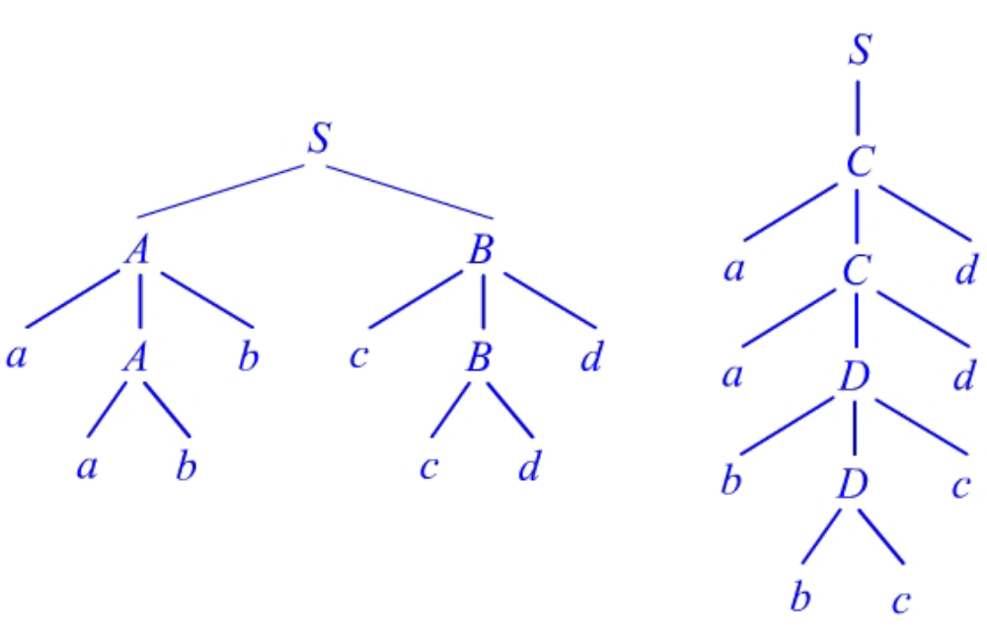

Inherent Ambiguity
parse trees for string $aabbccdd$

Slide 17

Inherent Ambiguity
There are two leftmost derivations:
  $S⇒_{lm}AB⇒_{lm}aAbB⇒_{lm}aabbB⇒_{lm}aabbcBd⇒_{lm}aabbccdd$
  $S⇒_{lm}C⇒_{lm}aCd⇒_{lm}aaDdd⇒_{lm}aabDcdd⇒_{lm}aabbccdd$
We can prove that every grammar for $L$ behaves like the above.
Therefore $L$ is inherently ambiguous.

Slide 18
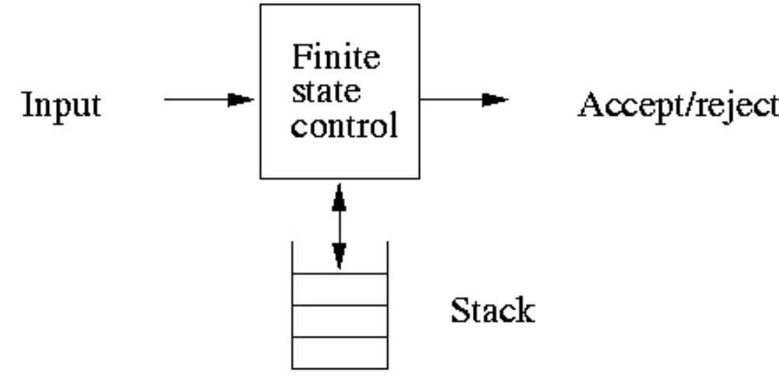

下推自动机（Pushdown Automata）
A pushdown automata (PDA) is essentially an $ε$-NFA with a stack

Slide 19

下推自动机（Pushdown Automata）
A PDA is a 7-tuple $P=(Q,Σ,Γ,δ,q_{0},Z_{0},F)$
  $Q$ is a finite set of states
  $Σ$ is a finite set of input symbols
  $Γ$ is a finite set of stack symbols
  $δ:Q×Σ^{ε}×Γ→2^{Q×Γ^{∗}}$ is a transition function
  $q_{0}∈Q$ is the start state
  $Z_{0}∈Γ$ is the start symbol of the stack
  $F⊆Q$ is a set of final (accepting) states

Slide 20

下推自动机（Pushdown Automata）
On a transition the PDA:
  Consumes an input symbol.
  Goes to a new state (or stays in the old).
  Replaces the symbol at the top of the stack by any string.
$\left(p,γ\right)∈δ(q,a,z)$
  at state q, encounter input a, with z at the top of stack
  go to state p, replace z with string $γ$
string $γ$ can be
  $ε$ ; same symbol z ; another symbol
  a string with more than one symbol

Slide 21

Example
Consider $L_{wwr}=\left\{ww^{R} \right| w∈{\left\{0,1\right\}}^{∗}\}$ with grammar $S→ε \left| 0S0 \right|1S1$
A PDA for $L_{wwr}$ can be constructed as follows
  reading w: stay in $q_{0}$ and push all symbols of w into the stack
  finish reading w: go from $q_{0}$ to $q_{1}$
  reading $w^{R}$: Compare it to the top of the stack. If match, pop the stack, and remain in state $q_{1}$. If not match, go to deadlock
  stack is empty: go to state $q_{2}$ and accept

Slide 22
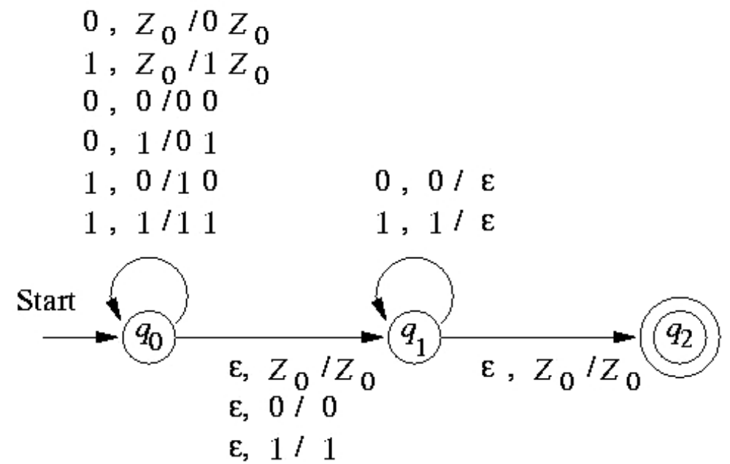

Example
PDA for $L_{wwr}$
transition label: $a,z/γ$ (read input $a$, replace $z$ with $γ$)

Slide 23
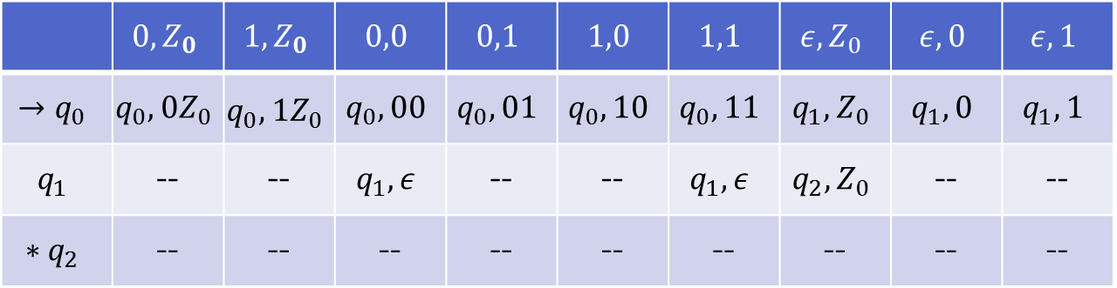

Example
$P=(\left\{q_{0},q_{1},q_{2}\right\},\left\{0,1\right\},\left\{0,1,Z_{0}\right\},δ,q_{0},Z_{0},\{q_{2}\})$
$δ$ is shown as follows
 | $$0,Z_{0}$$ | $$1,Z_{0}$$ | $$0,0$$ | $$0,1$$ | $$1,0$$ | $$1,1$$ | $$ε,Z_{0}$$ | $$ε,0$$ | $$ε,1$$
$$→q_{0}$$ | $$q_{0},0Z_{0}$$ | $$q_{0},1Z_{0}$$ | $$q_{0},00$$ | $$q_{0},01$$ | $$q_{0},10$$ | $$q_{0},11$$ | $$q_{1},Z_{0}$$ | $$q_{1},0$$ | $$q_{1},1$$
$$q_{1}$$ | -- | -- | $$q_{1},ε$$ | -- | -- | $$q_{1},ε$$ | $$q_{2},Z_{0}$$ | -- | --
$$∗q_{2}$$ | -- | -- | -- | -- | -- | -- | -- | -- | --

Slide 24

瞬时描述 (Instantaneous Description)
A ID of a PDA is a triple $(q,w,α)$
  $q$ is the current state
  $w$ is the remaining input string
  $α$ is the current stack contents
Transitions of ID
  $∀w∈Σ^{∗},β∈Γ^{∗}$
  $\left(q,aw,zβ\right)⊢(p,w,γβ)$ if $\left(p,γ\right)∈δ(q,a,z)$
define $⊢^{∗}$ to be the reflective-transitive closure of $⊢$
  basis: $I⊢^{∗}I$ for any ID $I$
  inductive: $I⊢^{∗}J$ if there is a $K$ such that $I⊢K$, $K⊢^{∗}J$

Slide 25
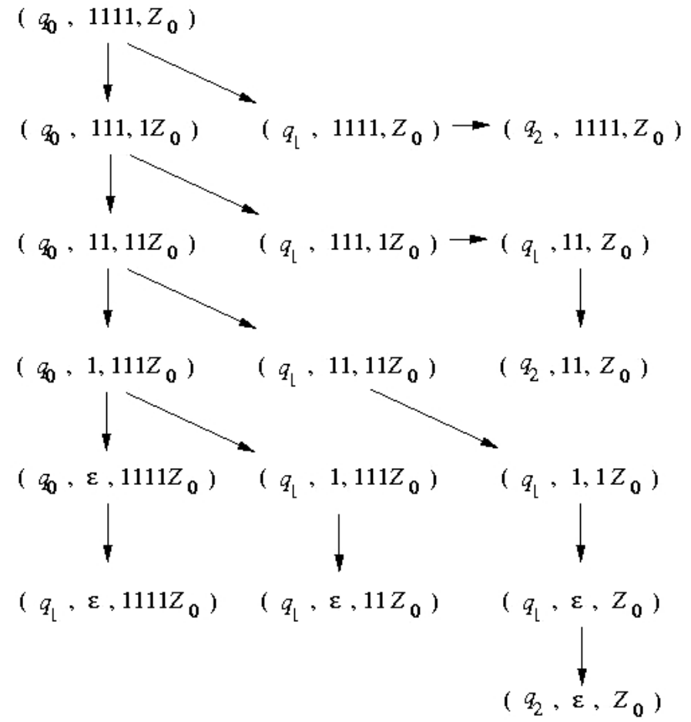
Computation
Computation sequence of string 1111

Slide 26


Theorems for $⊢^{∗}$
Let $P=\left(Q,Σ,Γ,δ,q_{0},Z_{0},F\right).$ Then $∀w∈Σ^{∗}, γ∈Γ^{∗}$
If $\left(q,x,α\right)⊢^{∗}\left(p,y,β\right)$ then $\left(q,xw,αγ\right)⊢^{∗}(p,yw,βγ)$
If $\left(q,xw,α\right)⊢^{∗}\left(p,yw,β\right)$ then $\left(q,x,α\right)⊢^{∗}(p,y,β)$

Slide 27

下推自动机接受的语言
Acceptance by the final state
  $L\left(P\right)=\left\{w \right| \left(q_{0},w,Z_{0}\right)⊢^{∗}\left(q,ε,α\right)∧q∈F\}$
Acceptance by the Empty Stack
  $N\left(P\right)=\left\{w \right| \left(q_{0},w,Z_{0}\right)⊢^{∗}(q,ε,ε)\}$

Slide 28

Equivalence of two acceptance
A language $L$ has a PDA that accepts it by final state iff $L$ has a PDA that accepts it by empty stack
$(⇐)$ If $L=N(P_{N})$ for some PDA $P_{N}=(Q,Σ,Γ,δ_{N},q_{0},Z_{0})$, then there exists a PDA $P_{F}$ such that $L=L(P_{F})$
Proof: construct
$P_{F}=\left(Q∪\left\{p_{0},p_{f}\right\},Σ,Γ∪\left\{X_{0}\right\},δ_{F},p_{0},X_{0},\{p_{f}\}\right)$
  $δ_{F}\left(p_{0},ε,X_{0}\right)=\{(q_{0},Z_{0}X_{0})\}$
  for all $q∈Q, a∈Σ, Y∈Γ$,
  $δ_{F}\left(q,a,Y\right)=δ_{N}(q,a,Y)$ and $\left(p_{f},ε\right)∈δ_{F}(q,ε,X_{0})$

Slide 29
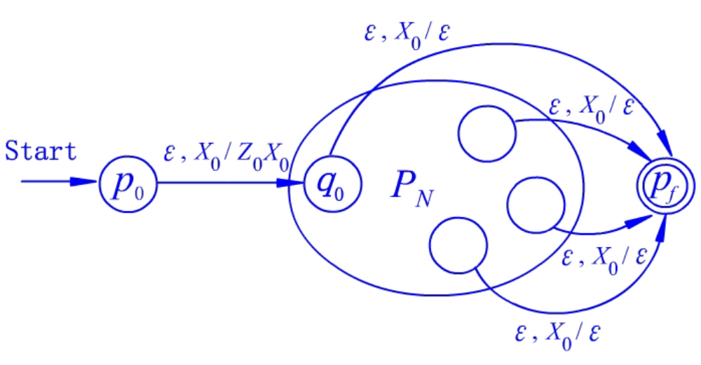


From $N(P_{N})$ to $L(P_{F})$
$L\left(P_{F}\right)=N(P_{N})$ with the following diagram

Slide 30
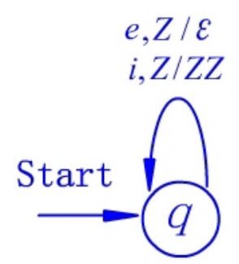
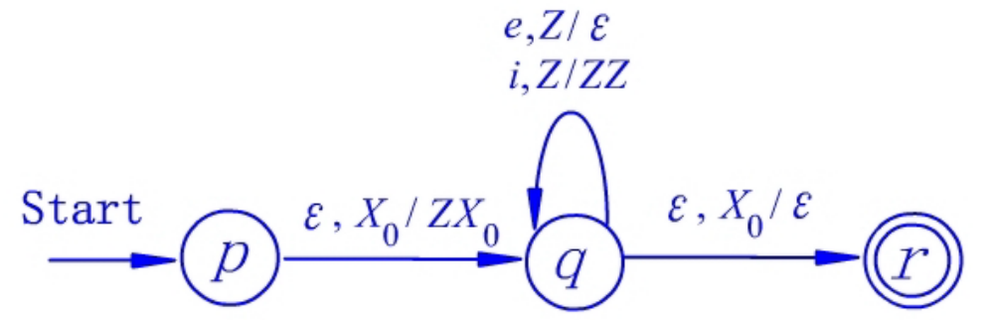

Example
Design $P_{N}$ for catching errors in strings meant to be in the if-else grammar G: $S→ε \left| SS \right| iS | iSe$
  $P_{N}=(\left\{q\right\},\left\{i,e\right\},\left\{Z\right\},δ_{N},q,Z)$
  $δ_{N}\left(q,i,Z\right)=\left\{\left(q,ZZ\right)\right\}, δ_{N}\left(q,e,Z\right)=\left\{\left(q,ε\right)\right\}$
Construct $P_{F}$ from $P_{N}$
  $P_{F}=(\left\{q,p,r\right\},\left\{i,e\right\},\left\{Z,X_{0}\right\},δ_{F},p,X_{0},\left\{r\right\})$
  $δ_{F}\left(p,ε,X_{0}\right)=\left\{\left(q,ZX_{0}\right)\right\}, δ_{F}\left(q,ε,X_{0}\right)=\{(r,ε)\}$

Slide 31


From $L(P_{F})$ to $N(P_{N})$
$(⇒)$ Let $P_{F}=(Q,Σ,Γ,δ_{F},q_{0},Z_{0},F)$. Then there is a PDA $P_{N}$ such that $L\left(P_{F}\right)=N(P_{N})$.
Proof:
Construct $P_{N}=(Q∪\left\{p_{0},p\right\},Σ,Γ∪\left\{X_{0}\right\},δ_{N},p_{0},X_{0})$
  $δ_{N}\left(p_{0},ε,X_{0}\right)=\left\{\left(q_{0},Z_{0}X_{0}\right)\right\}$
  for $Y∈Γ∪\{X_{0}\}$, $δ_{N}\left(p,ε,Y\right)=\{\left(p,ε\right)\}$
  for all $q∈Q,a∈Σ^{ε},Y∈Γ$, $δ_{N}\left(q,a,Y\right)=δ_{F}(q,a,Y)$
  for all $q∈F, Y∈Γ∪\{X_{0}\}$, $\left(p,ε\right)∈δ_{N}(q,ε,Y)$

Slide 32
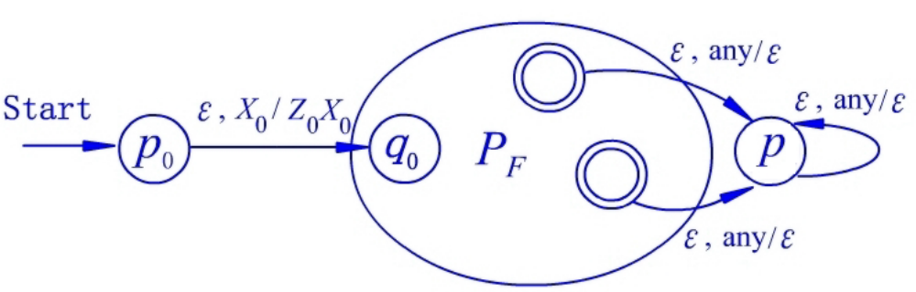
From $L(P_{F})$ to $N(P_{N})$
$L\left(P_{F}\right)=N(P_{N})$ with the following diagram

Slide 33

课后作业
给出接受以下语言的PDA
$L⊆{\left\{a,b,c\right\}}^{∗}$ and $\left|a\right|+\left|b\right|=|c|$

Slide 34
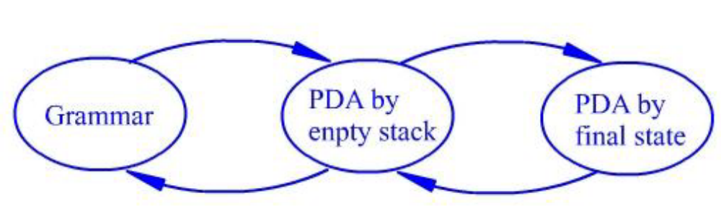
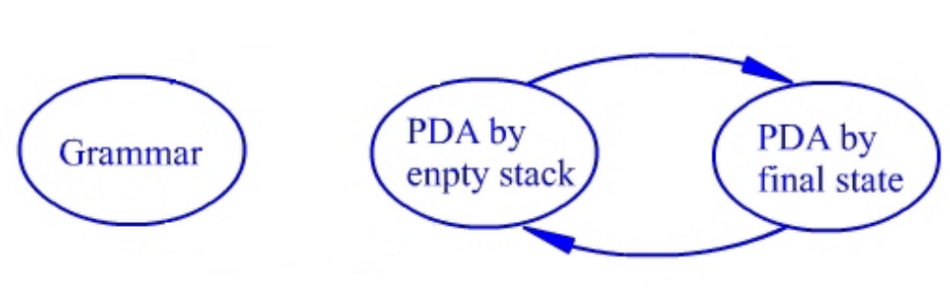
CFG和PDA的等价性
L is a language generated by a CFG iff it is accepted by a PDA
  a PDA accepts by empty stack
  a PDA accepts by final state

Slide 35

From CFG to PDA
Given a CFG $G=(V,T,R,S)$, we construct a PDA that simulates the leftmost derivations $⇒_{lm}^{∗}$
A left-sentential form $xAα$ where
$x∈T^{∗}, A∈V,α∈{\left(V∪T\right)}^{∗}$
$xAα⇒_{lm}xβα$ corresponds to the PDA that having consumed $x$ and having $Aα$ on the stack, and then it replaces $A$ with $β$ on $ε$ transition.
Then pop the terminals from the left of $β$ and expose the first variable symbol at the top of the stack.
Repeat the above

Slide 36

From CFG to PDA
Define $P_{G}=(\left\{q\right\},T,V∪T,δ,q,S)$
  For any $A∈V$, $δ\left(q,ε,A\right)=\left\{\left(q,β\right) \right| A→β∈R\}$
  For any $a∈T$, $δ\left(q,a,a\right)=\{\left(q,ε\right)\}$
Prove $N\left(P_{G}\right)=L(G)$
$(⇐)$ Let $w∈L(G)$. Then the derivation of $w$ is
$S=γ_{1}⇒_{lm}γ_{2}⇒_{lm}…⇒_{lm}γ_{n}=w$ where $γ_{i}=x_{i}α_{i}$.
Example
  $E⇒E×E⇒I×E⇒a×E⇒a×I⇒a×b$ $γ_{1} γ_{2} γ_{3} γ_{4} γ_{5} γ_{6}$

Slide 37


From CFG to PDA
We show by induction on i that if $S⇒_{lm}^{∗}x_{i}α_{i}$, then $\left(q,x_{i}y_{i},S\right)⊢^{∗}(q,y_{i},α_{i})$
Example
$$(q,a×b,E)$$ | $$γ_{1}$$
$$⊢(q,a×b,E×E)$$ | $$γ_{2}$$
$$⊢(q,a×b,I×E)$$ | $$γ_{3}$$
$$⊢\left(q,a×b,a×E\right)⊢\left(q,×b,×E\right)⊢(q,b,E)$$ | $$γ_{4}$$
$$⊢(q,b,I)$$ | $$γ_{5}$$
$$⊢\left(q,b,b\right)⊢(q,ε,ε)$$ | $$γ_{6}$$

Slide 38

From CFG to PDA
Basis: For $i=1, γ_{1}=S$. $x_{1}=ε, y=w$. Clearly $\left(q,w,S\right)⊢^{∗}(q,w,S)$
Inductive: Induction hypothesis is $\left(q,w,S\right)⊢^{∗}\left(q,y_{i},α_{i}\right)$
we have to show $\left(q,y_{i},α_{i}\right)⊢^{∗}(q,y_{i+1},α_{i+1})$
  let $α_{i}=Aχ$, we have $x_{i}Aχ⇒_{lm}x_{i}βχ=x_{i+1}Bμχ$ suppose $β=vBμ$
  By induction hypothesis $Aχ$ is on the stack, $y_{i}$ is the remaining input, then we can make the move
  $\left(q,y_{i},Aχ\right)⊢\left(q,y_{i},βχ\right)=(q,y_{i},vBμχ)$
  prefix $v$ can be popped and end up in $(q,y_{i+1},α_{i+1})$ where $α_{i+1}=Bμχ$ is the tail of $γ_{i+1}$

Slide 39

From CFG to PDA
$(⇒)$ If $w∈N(P_{G})$, then $w∈L(G)$
We show by induction on the length of $⊢^{∗}$ that
if $\left(q,w,S\right)⊢^{∗}(q,ε,ε)$, then $S⇒^{∗}w$
Basis: length 1. Then it must be $\left(q,ε,S\right)⊢\left(q,ε,ε\right)$ with $w=ε$. and we know that $S→ε$ in G and $S⇒ε$.
Inductive: length $n>1$. Induction hypothesis holds for length $<n$
  we must have $\left(q,w,S\right)⊢\left(q,w,Y_{1}Y_{2}…Y_{k}\right)⊢…⊢(q,ε,ε)$ where $S→Y_{1}Y_{2}…Y_{k}$ is in G

Slide 40

From CFG to PDA
we can write $w$ as $x_{1}x_{2}…x_{k}$ and have
for all $i=1,2,..,k$, $\left(q,x_{i}x_{i+1}…x_{k},Y_{i}\right)⊢^{∗}(q,x_{i+1}…x_{k},ε)$ is in less than $n$ steps
  If $Y_{i}∈T$, we have $Y_{i}=x_{i}$, thus $Y_{i}⇒^{∗}x_{i}$
  If $Y_{i}$ is not a terminal, by the induction hypothesis, we have $Y_{i}⇒^{∗}x_{i}$
So we have
$S⇒Y_{1}Y_{2}…Y_{k}⇒^{∗}x_{1}Y_{2}…Y_{k}⇒^{∗}x_{1}x_{2}…Y_{k}⇒^{∗}x_{1}x_{2}…x_{k}=w$

Slide 41
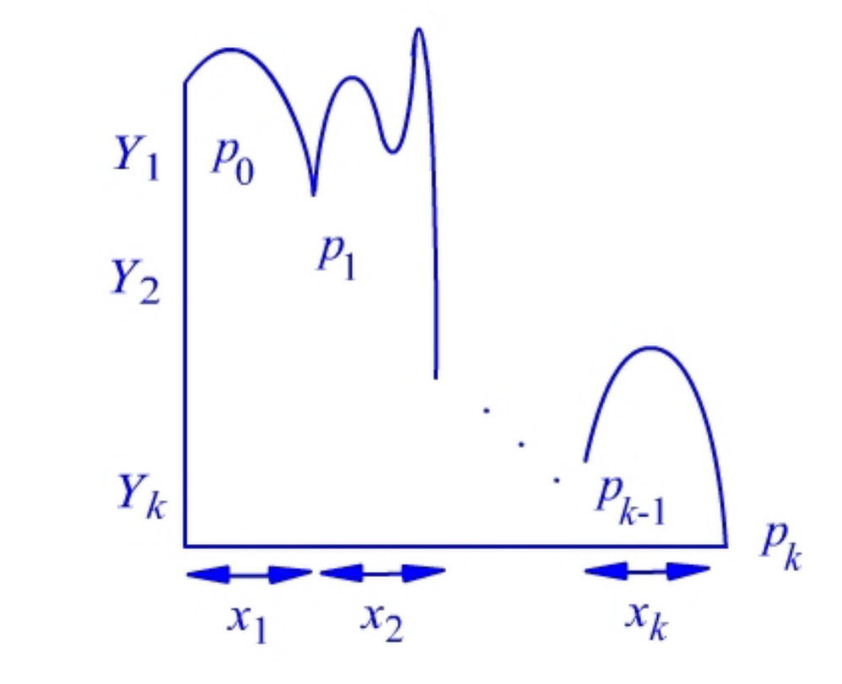

From PDA to CFG
How a PDA consume $w=x_{1}x_{2}…x_{k}$ and empty the stack

Slide 42

From PDA to CFG
Define a grammar with variables of the form
$[p_{i−1}Y_{i}p_{i}]$ representing from $p_{i−1}$ to $p_{i}$ by popping $Y_{i}$
Let $P=(Q,Σ,Γ,δ,q_{0},Z_{0})$ be a PDA.
Define $G_{P}=(V,Σ,R,S)$ where
  $V=\left\{\left[pXq\right] \right| \left\{p,q\right\}⊆Q, X∈Γ\}∪\{S\}$
  $R=\left\{S→\left[q_{0}Z_{0}p\right] \right| p∈Q\}∪$
  $\left\{\left[qXr_{k}\right]→a\left[rY_{1}r_{1}\right]…\left[r_{k−1}Y_{k}r_{k}\right] \right|$
  $a∈Σ^{ε}, \left\{r_{1},…,r_{k}\right\}⊆Q, \left(r,Y_{1}…Y_{k}\right)∈δ(q,a,X)\}$
  when $k=0$, we have $\left[qXr\right]→a$ for the case
  $\left(r,ε\right)∈δ(q,a,X)$

Slide 43


Example
Construct a Grammar by $P=(\left\{q\right\},\left\{i,e\right\},\left\{Z\right\},δ,q,Z)$
$G_{P}=(V,\left\{i,e\right\},R,S)$
  $V=\{\left[qZq\right],S\}$
  $R=\{S→\left[qZq\right], \left[qZq\right]→i\left[qZq\right]\left[qZq\right],\left[qZq\right]→e\}$
Replace $[qZq]$ by $A$, we get $S→A, A→iAA | e$

Slide 44

Example
Let $P=(\left\{p,q\right\},\left\{0,1\right\},\left\{X,Z_{0}\right\},δ,q,Z_{0})$
  $δ\left(q,1,Z_{0}\right)=\{\left(q,XZ_{0}\right)\}$
  $δ\left(q,1,X\right)=\left\{\left(q,XX\right)\right\}$
  $δ\left(q,0,X\right)=\left\{\left(p,X\right)\right\}$
  $δ\left(q,ε,Z_{0}\right)=\left\{\left(q,ε\right)\right\}$
  $δ\left(p,1,X\right)=\left\{\left(p,ε\right)\right\}$
  $δ\left(p,0,Z_{0}\right)=\left\{\left(q,Z_{0}\right)\right\}$
Construct the CFG $G_{P}$

Slide 45

Example
$G_{P}=(V,\left\{0,1\right\},R,S)$
  $V=\{S,\left[pXp\right],\left[pXq\right],\left[pZ_{0}p\right],\left[pZ_{0}q\right],\left[qXp\right],\left[qXq\right],\left[qZ_{0}p\right],\left[qZ_{0}q\right]\}$
Construct $R$
  $S→\left[qZ_{0}q\right] | [qZ_{0}p]$
  From rule (1): $δ\left(q,1,Z_{0}\right)=\left\{\left(q,XZ_{0}\right)\right\}$
  $\left[qZ_{0}q\right]→1\left[qXq\right]\left[qZ_{0}q\right] | 1[qXp][pZ_{0}q]$
  $\left[qZ_{0}p\right]→1\left[qXq\right]\left[qZ_{0}p\right] | 1[qXp][pZ_{0}p]$
  From rule (2): $δ\left(q,1,X\right)=\left\{\left(q,XX\right)\right\}$
  $\left[qXq\right]→1\left[qXq\right]\left[qXq\right] | 1[qXp][pXq]$
  $\left[qXp\right]→1\left[qXq\right]\left[qXp\right] | 1[qXp][pXp]$
  From rule (3): $δ\left(q,0,X\right)=\left\{\left(p,X\right)\right\}$
  $\left[qXq\right]→0\left[pXq\right]$
  $\left[qXp\right]→0[pXp]$

Slide 46

Example
From rule (4): $δ\left(q,ε,Z_{0}\right)=\left\{\left(q,ε\right)\right\}$
$\left[qZ_{0}q\right]→ε$
From rule (5): $δ\left(p,1,X\right)=\left\{\left(p,ε\right)\right\}$
$\left[pXp\right]→1$
From rule (6): $δ\left(p,0,Z_{0}\right)=\left\{\left(q,Z_{0}\right)\right\}$
$\left[pZ_{0}q\right]→0\left[qZ_{0}q\right]$
$\left[pZ_{0}p\right]→0[qZ_{0}p]$

Slide 47

From PDA to CFG
Prove $N\left(P\right)=L\left(G_{P}\right)$
Proof:
$(⇒)$ For any $w∈N(P)$, if $\left(q,w,Z_{0}\right)⊢^{∗}(p,ε,ε)$, then $\left[qZ_{0}p\right]⇒^{∗}w$
We show by induction on the length of $⊢^{∗}$
Basis: length 1. Then $w=a | ε$ and $\left(p,ε\right)∈δ(q,w,Z_{0})$. We have $\left[qZ_{0}p\right]→w$ in $G_{P}$ and thus $\left[qZ_{0}p\right]⇒^{∗}w$
Inductive: length $n>1$, IH holds for length $<n$
We must have $\left(q,w,Z_{0}\right)⊢\left(r_{0},x,Y_{1}Y_{2}…Y_{k}\right)⊢…⊢(p,ε,ε)$ for $w=ax$ where $a∈Σ^{ε}$
It follows that $\left(r_{0},Y_{1}Y_{2}…Y_{k}\right)∈δ(q,a,Z_{0})$. Then we have a production $\left[qZ_{0}r_{k}\right]→a\left[r_{0}Y_{1}r_{1}\right]…[r_{k−1}Y_{k}r_{k}]$ for all $\left\{r_{1},…,r_{k}\right\}⊆Q$

Slide 48

From PDA to CFG
Let $x=x_{1}x_{2}…x_{k}$ where $x_{i}$ is consumed when $Y_{i}$ is popped. Then $\left(r_{i−1},x_{i},Y_{i}\right)⊢^{∗}(r_{i},ε,ε)$
By IH we get $\left[r_{i−1}Y_{i}r_{i}\right]⇒^{∗}x_{i}$
We then have the following derivation: ($r_{k}=p$)
$\left[qZ_{0}r_{k}\right]⇒a\left[r_{0}Y_{1}r_{1}\right]…\left[r_{k−1}Y_{k}r_{k}\right]$
$⇒^{∗}ax_{1}\left[r_{1}Y_{2}r_{2}\right]\left[r_{2}Y_{3}r_{3}\right]…\left[r_{k−1}Y_{k}r_{k}\right]$
$⇒^{∗}ax_{1}x_{2}\left[r_{2}Y_{3}r_{3}\right]…\left[r_{k−1}Y_{k}r_{k}\right]$
$⇒^{∗}…⇒^{∗}ax_{1}x_{2}…x_{k}=w$

Slide 49

From PDA to CFG
$(⇐)$ If $\left[qZ_{0}p\right]⇒^{∗}w$, then $\left(q,w,Z_{0}\right)⊢^{∗}(p,ε,ε)$
We show by induction on the length of $⇒^{∗}$
Basis: length 1. Then we have $\left[qZ_{0}p\right]→w$. It follows that $\left(p,ε\right)∈δ(q,a,Z_{0})$ where $w=a$. Then we have $\left(q,w,Z_{0}\right)⊢(p,ε,ε)$
Inductive: length $n>1$, IH holds for length $<n$.
We must have: ($r_{k}=p$)
$\left[qZ_{0}r_{k}\right]⇒a\left[r_{0}Y_{1}r_{1}\right]\left[r_{1}Y_{2}r_{2}\right]…\left[r_{k−1}Y_{k}r_{k}\right]⇒^{∗}w$
we can break $w$ into $ax_{1}…x_{k}$ such that $\left[r_{i−1}Y_{i}r_{i}\right]⇒^{∗}x_{i}$
From IH we get $\left(r_{i−1},x_{i},Y_{i}\right)⊢^{∗}(r_{i},ε,ε)$
Then we get
$\left(r_{i−1},x_{i}x_{i+1}…x_{k},Y_{i}Y_{i+1}…Y_{k}\right)⊢^{∗}(r_{i},x_{i+1}…x_{k},Y_{i+1}…Y_{k})$

Slide 50

From PDA to CFG
Put all these derivation sequences together we get
$\left(q,ax_{1}x_{2}…x_{k},Z_{0}\right)$
$⊢\left(r_{0},x_{1}x_{2}…x_{k},Y_{1}Y_{2}…Y_{k}\right)$
$⊢^{∗}\left(r_{1},x_{2}…x_{k},Y_{2}…Y_{k}\right)$
$⊢^{∗}\left(r_{2},x_{3}…x_{k},Y_{3}…Y_{k}\right)$
$⊢^{∗}…⊢^{∗}(r_{k},ε,ε)$
Since $r_{k}=p$, we have shown that
$\left(q,w,Z_{0}\right)⊢^{∗}(p,ε,ε)$

Slide 51

确定的下推自动机
A PDA $P=(Q,Σ,Γ,δ,q_{0},Z_{0},F)$ is deterministic (DPDA) iff
  $δ\left(q,a,X\right)$ is always empty or a singleton for any $q∈Q, a∈Σ^{ε}$ and $X∈Γ$
  If $δ(q,a,X)$ is nonempty then $δ(q,ε,X)$ must be empty

Slide 52
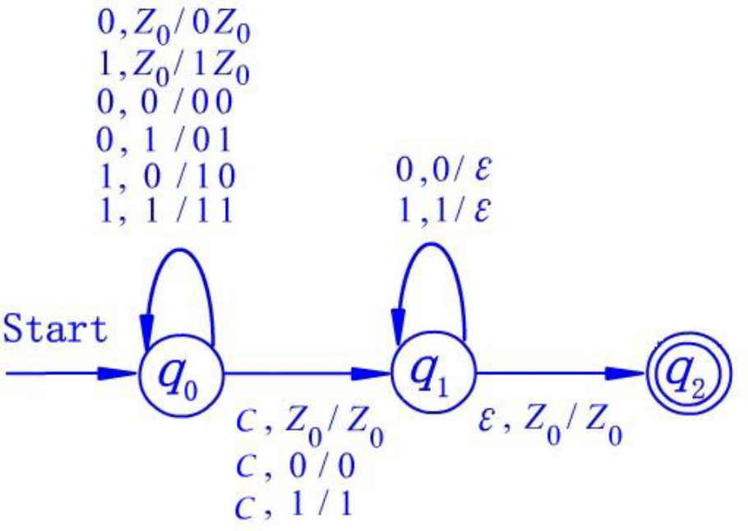

Example
Design a DPDA that can recognize
$L_{wcwr}=\left\{wcw^{R} \right| w∈{\left\{0,1\right\}}^{∗}\}$

Slide 53

RL, DPDA and CFL
Regular language $⊂L\left(DPDA\right)⊂$ Context-Free language
If $L$ is a RL, then $L$ can be accepted by some DPDA $P$ by final state
$L$ can be accepted by some DPDA $P$ by empty stack iff $L$ can be accepted by some DPDA $P′$ by final state and $L$ has the prefix property.
  Prefix property: $∀x,y∈L∙¬(x ≼ y)$

Slide 54

DPDA and unambiguity
If $L$ can be accepted by a DPDA $P$, then $L$ has an unambiguous CFG
Proof: By constructing a DPDA using above approach, the result is a CFG with unique leftmost derivation.
Example: $L_{wwr}$ has an unambiguous grammar
$S→0S0 \left| 1S1 \right| ε$

