Slide 1
形式语言与自动机理论
S3-2 上下文无关语言
李钦 副教授
华东师范大学
软件工程学院

Slide 2
上下文无关语言的性质
上下文无关文法的范式
上下文无关语言的封闭性
上下文无关语言的泵引理
上下文无关语言的判定性问题

Slide 3

上下文无关文法的范式
Chomsky Normal Form (CNF)
  Every production is of the form $A→BC$ or $A→a$
  $A,B,C∈V$ and $a∈T$
Greibach Normal Form (GNF)
  Every production is of the form $A→aα$
  $A∈V$, $a∈T$ and $α∈V^{∗}$

Slide 4

CFG的化简
Eliminate useless symbols
  that do not appear in any derivation $S⇒^{∗}w$
Eliminate $ε$-productions
  that $A→ε$
Eliminate unit productions
  that $A→B$

Slide 5

Eliminate useless symbols
A symbol $X$ is useful if there is a derivation
$S⇒^{∗}αXβ⇒^{∗}w$
  $w∈T^{∗}$ and $X∈V∪T$
A useful symbol is both generating and reachable
  Generating: $X⇒^{∗}w$ for some $w∈T^{∗}$
  Reachable: $S⇒^{∗}αXβ$ for some $\left\{α,β\right\}⊆{\left(V∪T\right)}^{∗}$
Eliminate non-generating symbols
Eliminate non-reachable symbols

Slide 6

Example
Let $G$ be $S→AB|a, A→b$
  $S, A, a, b$ are generating
  $B$ is not generating
Eliminate $B$ by eliminate $S→AB$
$S→a$, $A→b$
  only $S$ and $a$ are reachable
Eliminate $A$ and $b$ by eliminate $A→b$
$S→a$
$L\left(G\right)=\{a\}$

Slide 7

Theorem
If $G=(V,T,P,S)$ be a CFG with $L(G)≠∅$. Let $G_{1}=(V_{1},T_{1},P_{1},S)$ be the grammar obtained by eliminating all non-generating symbols and then all non-reachable symbols
Then $G_{1}$ has no useless symbols and $L\left(G_{1}\right)=L(G)$

Slide 8

Algorithm
Computing generating symbols $g(G)$
  Basis: $g\left(G\right)=T$
  Inductive: If $X→α∈P$ and every symbol of $α$ is in $g(G)$, then $g\left(G\right)=g\left(G\right)∪\{X\}$
Example: Let $G$ be $S→AB|a, A→b$
  First $g\left(G\right)=\{a,b\}$
  Since $S→a$, we get $g\left(G\right)=\{a,b,S\}$
  Since $A→b$, we get $g\left(G\right)=\{a,b,S,A\}$
$g(G)$ contains all and only generating symbols

Slide 9

Algorithm
Computing reachable symbols $r(G)$
  Basis: $r\left(G\right)=\{S\}$
  Inductive: If $A∈r(G)$ and $A→α∈P$, then
  $r\left(G\right)=r\left(G\right)∪\{all symbols in α\}$
Example: Let $G$ be $S→AB|a, A→b$
  First $r\left(G\right)=\{S\}$
  Since $S→AB$, we get $r\left(G\right)=\{S,A,B\}$
  Since $S→a$, we get $r\left(G\right)=\{S,A,B,a\}$
  Since $A→b$, we get $r\left(G\right)=\{S,A,B,a,b\}$
$r(G)$ contains all and only the reachable symbols

Slide 10


Eliminating $ε$-productions
Variable $A$ is nullable if $A⇒^{∗}ε$
Computing nullable symbols $n(G)$
  Basis: $n\left(G\right)=\left\{A \right| A→ε∈P\}$
  Inductive: If $A→C_{1}C_{2}…C_{k}∈P$ and $\left\{C_{1},C_{2},…,C_{k}\right\}⊆n\left(G\right)$,
  then $n\left(G\right)=n\left(G\right)∪\{A\}$
$n(G)$ contains all and only the nullable symbols
Let $A$ be nullable
  Replace $A→BAD$ with two productions $A→BAD, A→BD$
  Delete all productions of the form $A→ε$

Slide 11

Example
Let $G$: $S→AB, A→aAA \left| ε, B→bBB \right| ε$
Compute nullable symbols
  First $n\left(G\right)=\{A,B\}$
  Since $S→AB$ and $\left\{A,B\right\}⊆n(G)$, we get $n\left(G\right)=\{A,B,S\}$
Replace productions with nullable symbols
  $S→AB \left| A \right| B$
  $A→aAA \left| aA \right| a \left| ε, B→bBB \left| bB \right| b \right| ε$
Eliminate $ε$-productions $A→ε, B→ε$
$S→AB \left| A \right| B, A→aAA \left| aA \right| a , B→bBB \left| bB \right| b$

Slide 12

Theorem
If $G$ is CFG and $G_{1}$ is obtained by eliminating $ε$-productions in $G$, then $L\left(G_{1}\right)=L\left(G\right)\backslash \{ε\}$

Slide 13

Eliminating Unit Production
A unit production is of the form $A→B$
$(A,B)$ is a unit pair if $A⇒^{∗}B$ using unit productions only
Compute unit pairs $u(G)$
  Basis: $u\left(G\right)=\left\{\left(A,A\right) \right| A∈V\}$
  Inductive: If $\left(A,B\right)∈u(G)$ and $B→C∈P$, then add $(A,C)$ to $u(G)$
$u(G)$ contains all and only unit pairs
Given a CFG $G=\left(V,T,P,S\right)$, construct $G_{1}=(V,T,P_{1},S)$
  For each unit pair $(A,B)$, add all productions $A→α$ to $P_{1}$ when $B→α$ is not a unit production in $P$

Slide 14
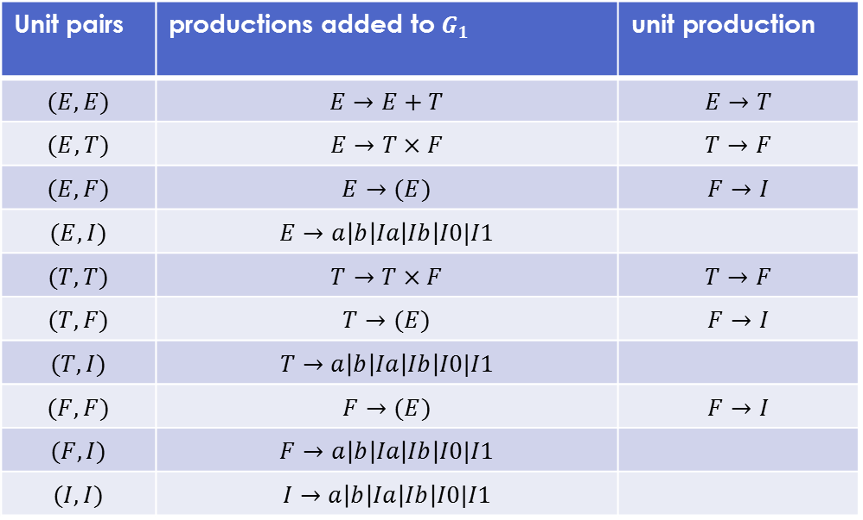

Example
Let $G$:
  $I→a\left|b\right|Ia\left|Ib\right|I0\left|I1, F→I\right|\left(E\right), T→F\left|T×F, E→T\right|E+T$
We get first $u\left(G\right)=\{\left(E,E\right),\left(T,T\right),\left(F,F\right),\left(I,I\right)\}$
Unit pairs | productions added to $G_{1}$ | unit production
$$(E,E)$$ | $$E→E+T$$ | $$E→T$$
$$(E,T)$$ | $$E→T×F$$ | $$T→F$$
$$(E,F)$$ | $$E→(E)$$ | $$F→I$$
$$(E,I)$$ | $$E→a\left|b\right|Ia\left|Ib\right|I0|I1$$
$$(T,T)$$ | $$T→T×F$$ | $$T→F$$
$$(T,F)$$ | $$T→(E)$$ | $$F→I$$
$$(T,I)$$ | $$T→a\left|b\right|Ia\left|Ib\right|I0|I1$$
$$(F,F)$$ | $$F→(E)$$ | $$F→I$$
$$(F,I)$$ | $$F→a\left|b\right|Ia\left|Ib\right|I0|I1$$
$$(I,I)$$ | $$I→a\left|b\right|Ia\left|Ib\right|I0|I1$$

Slide 15

Theorem
Let $G$ be CFG, $G_{1}$ is constructed from $G$ by eliminating unit productions, then $L\left(G_{1}\right)=L(G)$

Slide 16

Simplify CFG
A safe order for simplifying a CFG
Eliminating $ε$-productions
Eliminating unit productions
Eliminating useless symbols
Theorem:
If $G$ is a CFG that $L(G)≠∅$, then there is another CFG $G′$ that has no $ε$-productions, unit productions and useless symbols such that
$L\left(G^{′}\right)=L\left(G\right)\backslash \{ε\}$

Slide 17

Example
Consider the following CFG $G$
  $S→H | G$
  $H→1FH | 1ED$, $G→1FG | 1EC$
  $F→1FF \left| 1EB \right| 0B, E→1FE \left| 1EA \right| 0A$
  $H→ε, A→1, D→0H, C→0G$

Slide 18

Example
Eliminating $ε$-productions
  compute $n\left(G\right)=\{H,S\}$
Replace and eliminate nullable symbol $H,S$
We get $G_{1}$ from $G$
  $S→H | G$
  $H→1F | 1FH | 1ED$, $G→1FG | 1EC$
  $F→1FF \left| 1EB \right| 0B, E→1FE \left| 1EA \right| 0A$
  $A→1, D→0H | 0, C→0G$

Slide 19

Example
Eliminating unit productions
  compute $u\left(G_{1}\right)=id_{V}∪\{\left(S,G\right),(S,H)\}$
Eliminate $S→H$ and $S→G$
We get $G_{2}$ from $G_{1}$
  $S→1F \left| 1FH \right| 1ED \left| 1FG \right| 1EC$
  $H→1F | 1FH | 1ED$, $G→1FG | 1EC$
  $F→1FF \left| 1EB \right| 0B, E→1FE \left| 1EA \right| 0A$
  $A→1, D→0H | 0, C→0G$

Slide 20

Example
Eliminating non-generating symbols
  compute $g\left(G_{2}\right)=\{0,1,A,D,E,H,S\}$
Eliminate symbol $G,F,C,B$
We get $G_{3}$ from $G_{2}$
  $S→1ED$
  $H→1ED$
  $E→1EA | 0A$
  $A→1$
  $D→0H | 0$

Slide 21

Example
Eliminating non-reachable symbols
  compute $r\left(G_{3}\right)=\{S,1,E,D,A,0,H\}$
All symbols are reachable
Remove all single production for $A$ and $H$
We get final CFG $G′$
  $S→1ED$
  $E→1E1 | 01$
  $D→01ED | 0$

Slide 22

Convert to CNF
Given a CFG
Simplify the CFG
Arrange that all bodies of length 2 or more consists only of variables
  for every $a$ in a body of length $≥2$, replace $a$ by a new variable $A$ and add production $A→a$
Break bodies of length 3 or more into a cascade of two-variable-bodied productions
  for each rule $A→B_{1}B_{2}…B_{k}$, add new variables $C_{1},C_{2},…,C_{k−2}$
  replace the rule by $A→B_{1}C_{1}, C_{1}→B_{2}C_{2}, …C_{k−2}→B_{k−1}B_{k}$

Slide 23
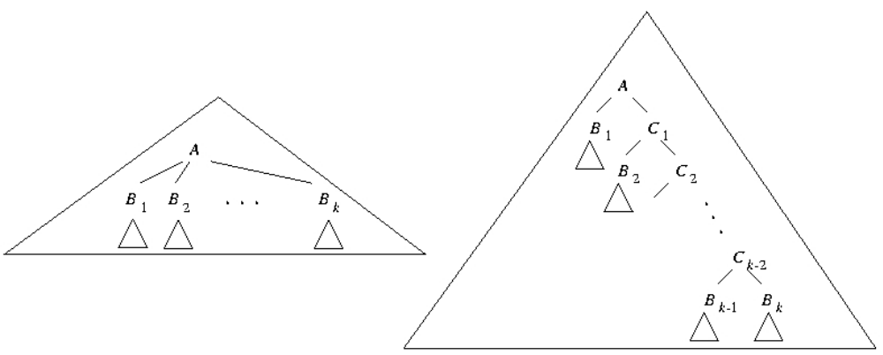
Convert to CNF

Slide 24

Example
Convert the following CFG to CNF
  $E→E+T \left| T×F \right| \left(E\right) \left| a \right| b \left| Ia \right| Ib \left| I0 \right| I1$
  $T→T×F \left| \left(E\right) \right| a \left| b \right| Ia \left| Ib \right| I0 | I1$
  $F→\left(E\right) \left| a \right| b \left| Ia \left| Ib \right| I0 \right|I1$
  $I→a | b | Ia \left| Ib \right| I0 | I1$
Step 1: already done

Slide 25

Example
Step 2
  Rules with length 2 or more
    $E→E+T \left| T×F \right| \left(E\right) \left| Ia \right| Ib \left| I0 \right| I1$
    $T→T×F \left| \left(E\right) \right| Ia \left| Ib \right| I0 | I1$
    $F→\left(E\right) \left| Ia \left| Ib \right| I0 \right|I1$
    $I→Ia \left| Ib \right| I0 | I1$
  Adding rules
    $A→a, B→b, Z→0, O→1, P→+, M→×, L→(, R→)$
  Replacing rules
    $E→EPT \left| TMF \right| LER \left| IA \right| IB \left| IZ \right| IO$
    $T→TMF \left| LER \right| IA \left| IB \right| IZ | IO$
    $F→LER \left| IA \left| IB \right| IZ \right|IO$
    $I→IA \left| IB \right| IZ | IO$

Slide 26

Example
Step 3
  Rules with length 3 or more
    $E→EPT \left| TMF \right| LER$
    $T→TMF | LER$
    $F→LER$
  Break them to small rules
    $C_{1}→PT, C_{2}→MF, C_{3}→ER$
  Replacing rules
    $E→EC_{1} \left| TC_{2} \right| LC_{3}$
    $T→TC_{2} | LC_{3}$
    $F→LC_{3}$

Slide 27

Convert to CNF
Advantage:
  Remove redundancy from grammar
  Determine the equivalence of two CFLs by comparing the rules of their grammars
  Make the parse tree of a string w to be a binary tree
    so that the depth of the parse tree satisfies $\left|w\right|≤2^{n−1}$

Slide 28

Pumping lemma for CFL
To prove that a language $L$ is not context-free
Let $L$ be a CFL. Then there exists a constant $n$ such that if $z$ is any string in $L$ with $\left|z\right|>n$, then we can write $z=uvwxy$ where
  $\left|vwx\right|≤n$
  $\left|vx\right|>0$
  For all $i≥0$, $uv^{i}wx^{i}y∈L$
Two substrings $v$ and $x$ can be pumped

Slide 29
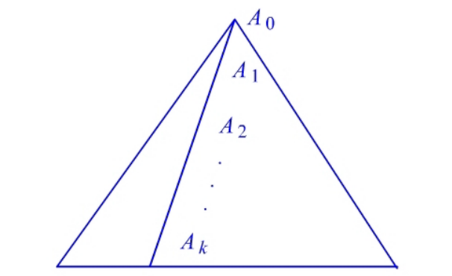

Proof
Let $L≠∅$, $L≠\{ε\}$, we can find a CNF grammar G so that $L\left(G\right)=L\backslash \{ε\}$. Let $G$ have $m$ variables and choose $n=2^{m}$. Suppose $z∈L$ has length $\left|z\right|≥n$.
By the property of CNF parse tree, $z$ can be yielded by a parse tree with a path of length $≥m+1$
choose the longest path in the parse tree yielding z, there must be at least $m+1$ occurrence of variables $A_{0}, A_{1},…,A_{k}(k≥m)$

Slide 30
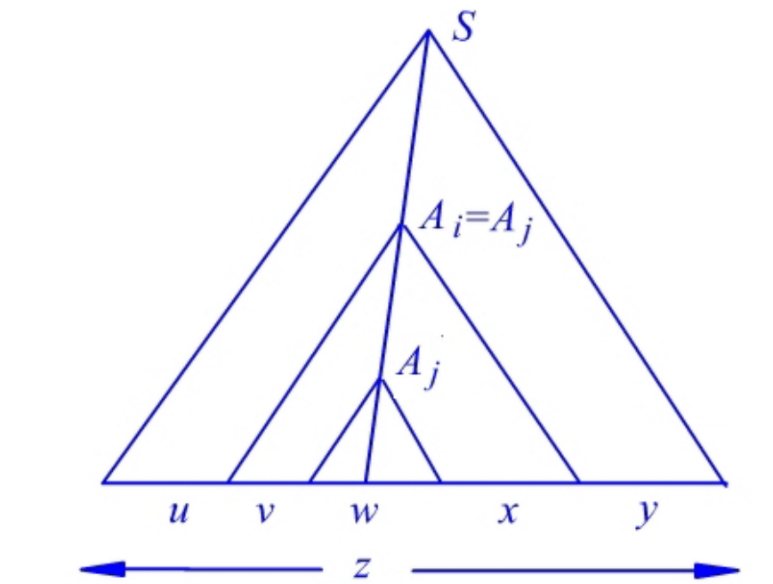

Proof
As there are only $m$ different variables in $V$, then there are at least two variables $A_{i}=A_{j}$ where
$k−m≤i<j≤k$. We can divide the tree as

Slide 31
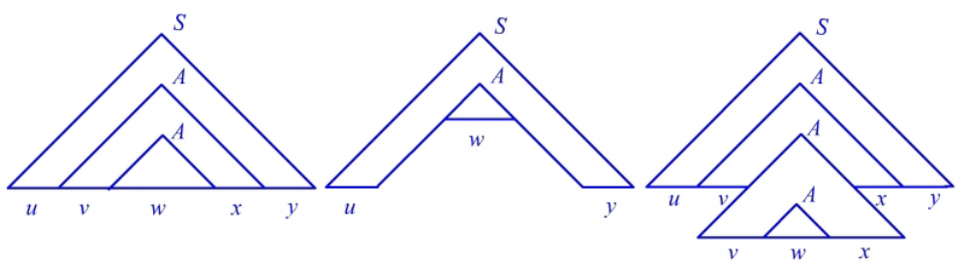

Proof
If $A_{i}=A_{j}=A$, then we can construct new parse trees from original tree.
Then we have proved the pumping lemma.

Slide 32

Applications of pumping lemma
Determing $L=\left\{0^{m}1^{m}2^{m} \right| m≥1\}$ is not a CFL
Suppose $L$ was CFL. Then from the pumping lemma, there is a $n$ such that for any string $z$, $z=uvwxy$ satisfying $\left|vwx\right|≤n$ and $\left|vx\right|>0$
Let $z=0^{n}1^{n}2^{n}$. Then we know that $vwx$ cannot contain both 0 and 2, because they are separated by $n$ numbers of 1, discuss the two cases:
  $vwx$ has no 2. Then $vx$ contains only 0 and 1 and at least one of them. According to pumping lemma, $uwy∈L$. But it is impossible since $y$ has n number of 2 and $uw$ has fewer 0 and 1. Contradiction.
  $vwx$ has no 0. The proof is similar. Contradiction.

Slide 33

CFL的封闭性
Let $L, M$be CFLs, then the languages composed by the following operators are CFL
  substitution: $s(L)$
  union: $L∪M$
  intersection: $L∩R$ where $R$ is a RL
  concatenation: $L.M$
  closure: $L^{∗}$, $L^{+}$
  reverse: $L^{R}$
  minus regular: $L−R$ where $R$ is a RL
  homomorphism: $h(L)$, $h^{−1}(L)$

Slide 34

Substitution
Let $Σ, Δ$ be finite alphabets
$s:Σ→2^{Δ^{∗}}$ is a mapping such that for any $a∈Σ$, $s(a)$ is a language over $Δ$
Let $w∈Σ^{∗}$ and $w=a_{1}a_{2}…a_{n}$, define
$s\left(w\right)=\left\{b_{1}b_{2}…b_{n} \right| b_{1}∈s\left(a_{1}\right),b_{2}∈s\left(a_{2}\right),…,b_{n}∈s(a_{n})\}$
for $L⊆Σ^{∗}$, $s\left(L\right)=\bigcup_{w∈L}{s(w)}$

Slide 35

Example
Let $Σ=\left\{0,1\right\}, Δ=\{a,b\}$,
  $s\left(0\right)=\left\{a^{n}b^{n} \right| n≥1\}, s(1)=\{aa,bb\}$
For $w=01$, we have
  $s\left(w\right)=s\left(0\right).s\left(1\right)=\left\{a^{n}b^{n}aa \right| n≥1\}∪\{a^{n}b^{n+2} | n≥1\}$
For $L={\left\{0\right\}}^{∗}$, we have
  $s\left(L\right)=s{\left(0\right)}^{∗}=\left\{a^{n_{1}}b^{n_{1}}a^{n_{2}}b^{n_{2}}…a^{n_{k}}b^{n_{k}} \right| k≥0, n_{i}≥1\}$

Slide 36

Substitution Theorem
Let $L$ be a CFL over $Σ$, and $s$ a substitution, such that $s(a)$ is a CFL for any $a∈Σ$. Then $s(L)$ is a CFL
Proof:
From the grammar $G=(V,Σ,P,S)$ for $L$ and $G_{a}=(V_{a},T_{a},P_{a},S_{a})$ for each $s\left(a\right)$, we construct CFG $G^{′}=(V^{′},T^{′},P^{′},S^{′})$ where
  $V^{′}=V∪ \bigcup_{a∈Σ}{V_{a}}$
  $T^{′}=\bigcup_{a∈Σ}{T_{a}}$
  $P^{′}=\bigcup_{a∈Σ}{P_{a}} ∪\left\{A→αS_{a}β\right| A→αaβ∈P\}$

Slide 37
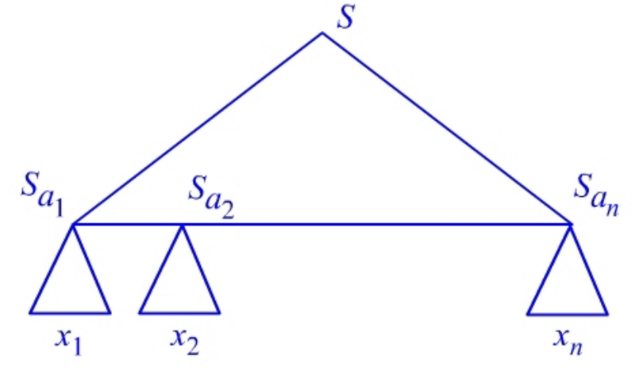

Proof
$L\left(G^{′}\right)=s(L)$
$(⇐)$ Let $w∈s(L)$, then $∃y∈L$ such that $w∈s(y)$.
Let $y=a_{1}a_{2}…a_{n}$, then $w∈s\left(a_{1}\right).s\left(a_{2}\right)…s(a_{n})$. That is $∃x_{i}∈s(a_{i})$ such that $w=x_{1}x_{2}…x_{n}$
Thus we have $w∈L(G^{′})$

Slide 38

上下文无关语言的判定性问题
Given a CFL $L$, determine
$L=∅$
$w∈L$

Slide 39

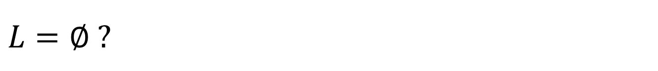
$$L=∅ ?$$
Given a CFG $G=(V,T,P,S)$ for $L$, determine whether the start symbol $S$ is generating.
Algorithm
  basis: $g\left(G\right)≔T$
  Inductive: If $X→α∈P$ and every symbol of $α$ is in $g(G)$, then $g\left(G\right)≔g\left(G\right)∪\{X\}$
  $L=∅$ iff $S∉g\left(G\right)$
Complexity of the above algorithm
  $O\left(n^{2}\right)$ if $\left|P\right|=n$

Slide 40
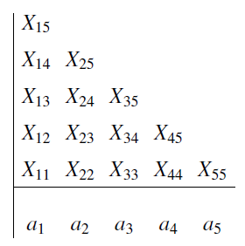


$$w∈L ?$$
CYK algorithm
Given a CNF grammar $G=(V,T,P,S)$ for $L$. $w=a_{1}a_{2}…a_{n}∈T^{∗}$. Construct a table as follows
  $X_{ij}$ is the set of variables $A$ such that $A⇒^{∗}a_{i}a_{i+1}…a_{j}$
  $w∈L$ iff $S∈X_{1n}$

Slide 41

CYK algorithm
Computing $X_{ij}$
basis: $X_{ii}=\left\{A \right| A→a_{i}∈P\}$
Inductive: suppose we have computed all entries at row $j−i$. Compute $X_{ij}$ at row $j−i+1$
  Add $A$ into $X_{ij}$, if we find that $∃k.i≤k<j$
    $A→BC∈P$
    $B∈X_{ik}$
    $C∈X_{\left(k+1\right)j}$

Slide 42
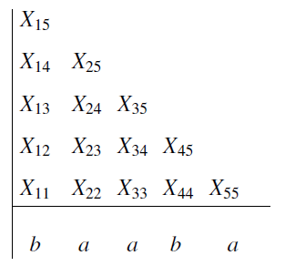
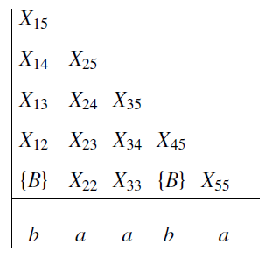
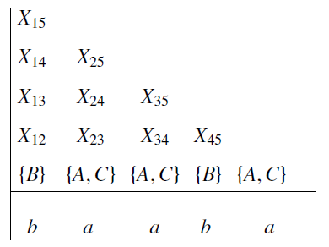
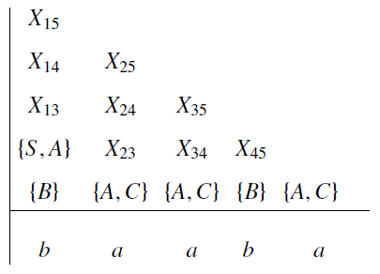
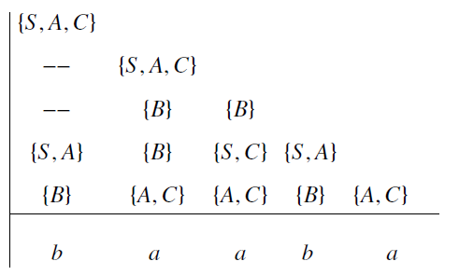
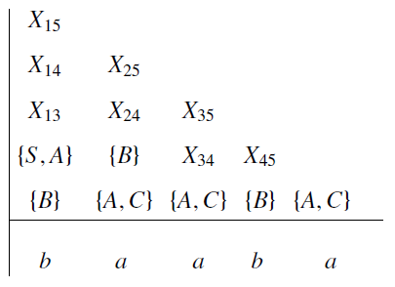
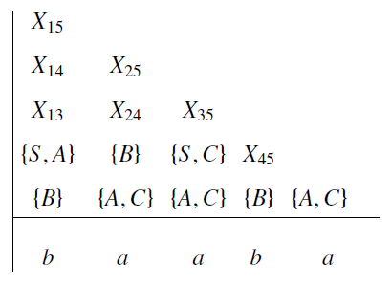
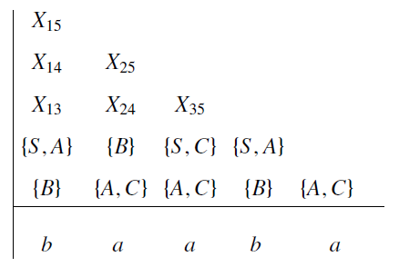

Example
Given a CNF grammar $G$:
  $S→AB | BC$, $A→BA | a$, $B→CC | b$, $C→AB | a$
Determine $baaba∈L(G)$
Fill the following table

Slide 43

Undecidable Problems about CFLs
Is a given CFG G ambiguous?
Is a given CFL inherently ambiguous?
Is the intersection of two CFLs empty?
Are two CFLs the same?
Is a given CFL equal to $Σ^{∗}$?

